Slide 1
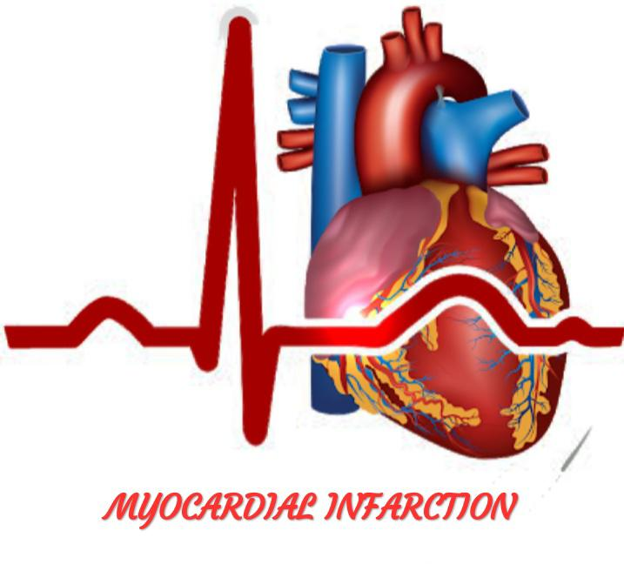

Slide 2
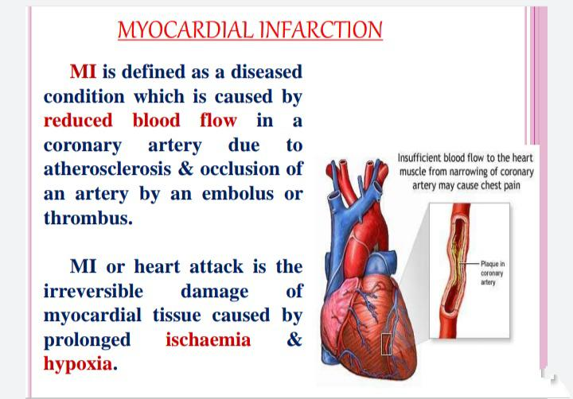

Slide 3


Slide 4
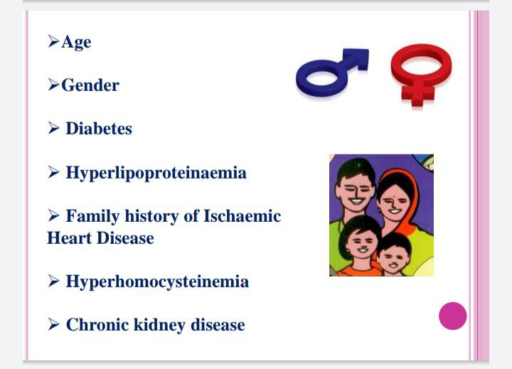

Slide 5
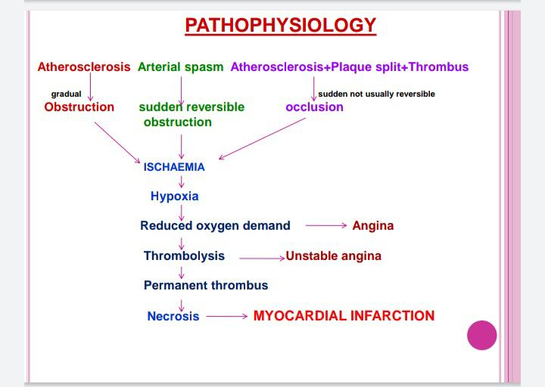

Slide 6
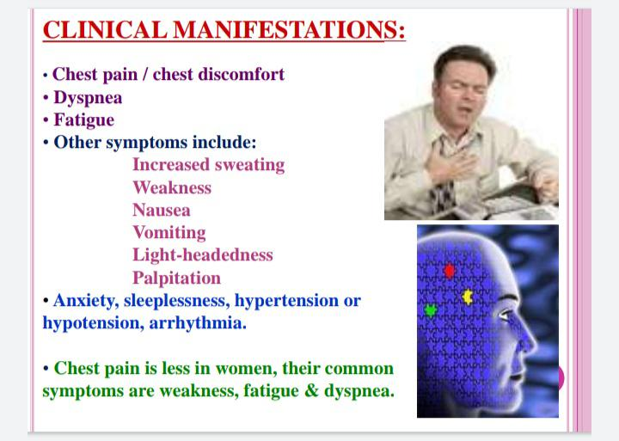

Slide 7
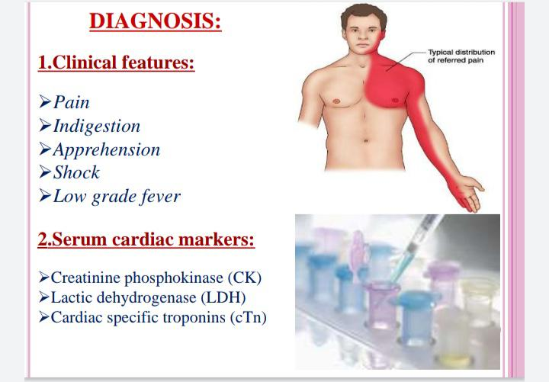

Slide 8
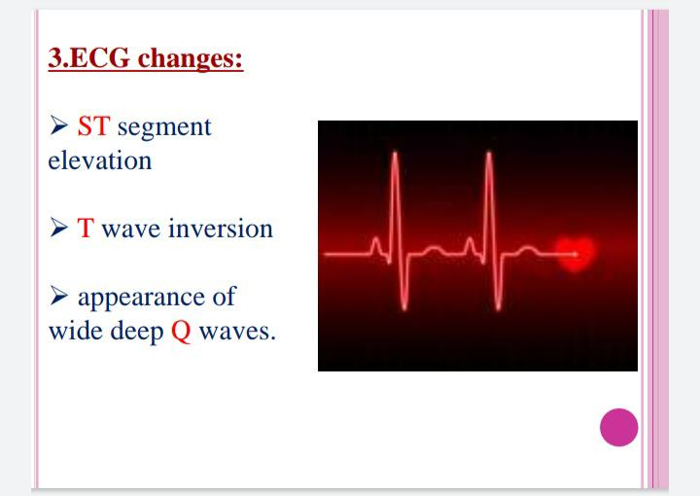

Slide 9
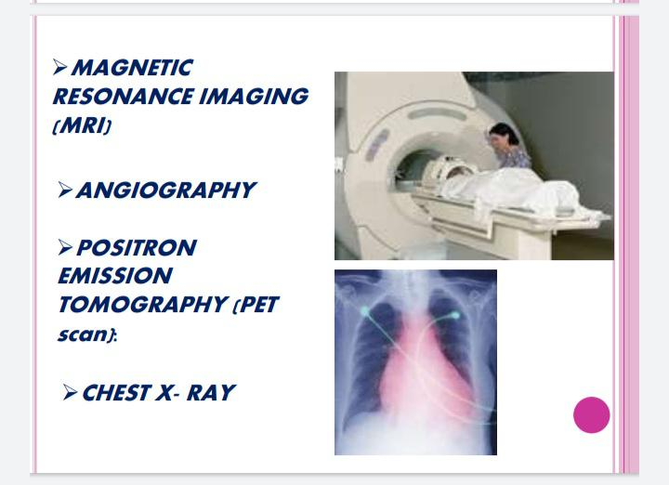

Slide 10
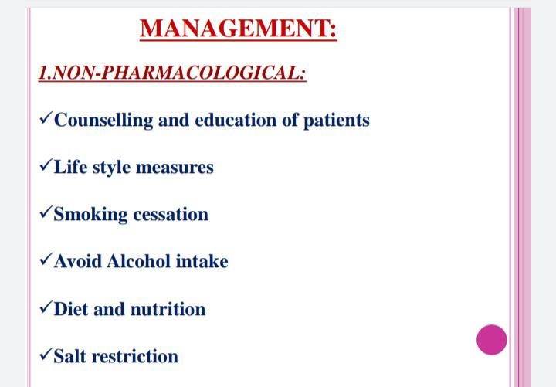

Slide 11
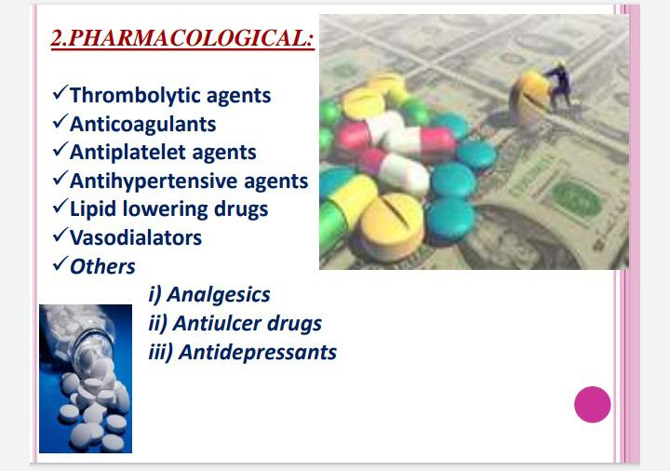

Slide 12
SURGICAL MANAGEMENT
👇

Slide 13
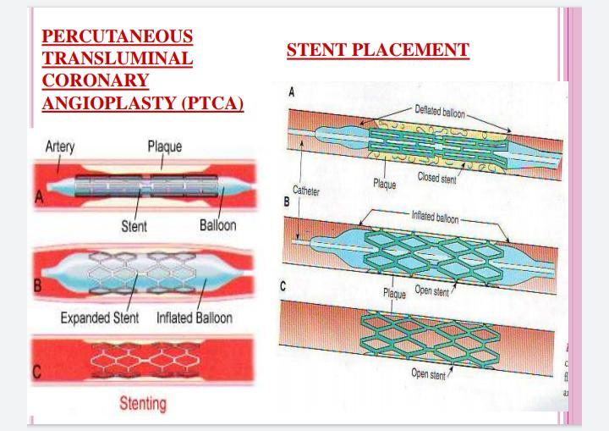

Slide 14
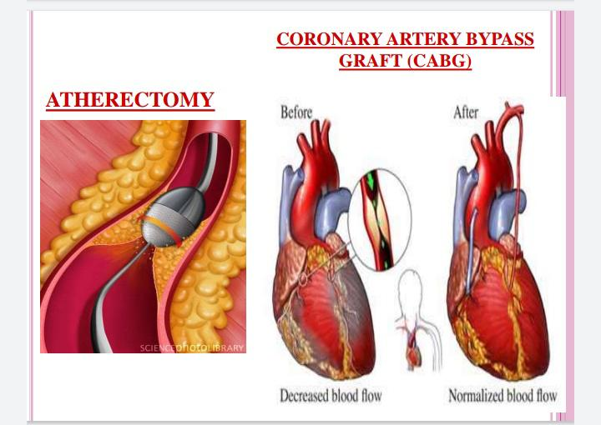

Slide 15
Nursing Management
Assess for chest pain not relieved by rest or medications.
Monitor vital signs, especially the blood pressure and pulse rate.
Assess for presence of shortness of breath, dyspnea, tachypnea, and crackles.

Slide 16
Assess for nausea and vomiting.
Assess for decreased urinary output.
Assess for the history of illnesses.
Perform a precise and complete physical assessment to detect complications and changes in the patient’s status.
Assess IV sites frequently.

Slide 17
Administer oxygen along with medication therapy to assist with relief of symptoms.
Encourage bed rest with the back rest elevated to help decrease chest discomfort and dyspnea.
Encourage changing of positions frequently to help keep fluid from pooling in the bases of the lungs.

Slide 18
Check skin temperature and peripheral pulses frequently to monitor tissue perfusion.
Provide information in an honest and supportive manner.
Monitor the patient closely for changes in cardiac rate and rhythm, heart sounds, blood pressure, chest pain, respiratory status, urinary output, changes in skin color, and laboratory values.

Slide 19
NURSING DIAGNOSIS??

Slide 20
THANK YOU ☺

