Slide 2
DEFINITION
Scabies is a contagious disease caused by the mite sarcoptes scabiei.

Slide 3
CAUSE
A microscopic mite called the human itch mite (Sarcoptes scabiei var. hominis)

Slide 4
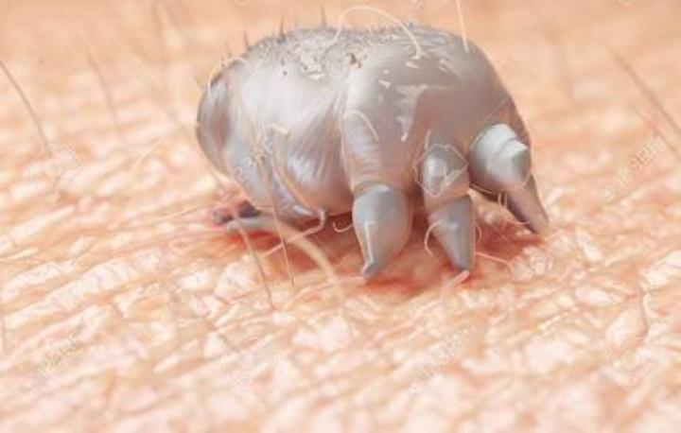
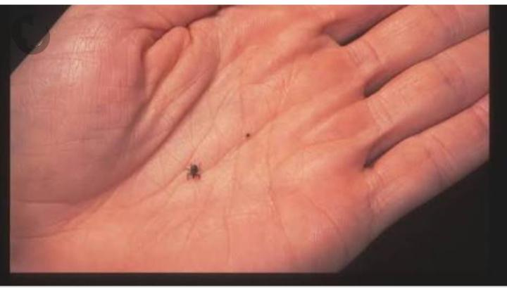

Slide 5
Scabies is the result of an infestation of tiny, eight-legged mites. These bugs are so small you can’t see them on your skin, but you can certainly see their effects.
The mites will burrow into the top layer of your skin to live and feed. Female mites will lay eggs. Your skin will react to the mites and their waste, and you’ll develop a red, itchy rash.

Slide 6
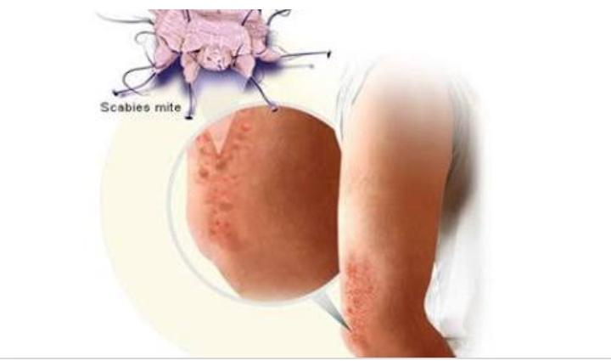

Slide 7
EPIDEMIOLOGY & DEMOGRAPHICS
Mites are distributed worldwide
❖ affects all races and socioeconomic classes in all climates
Higher prevalence in urban areas
Greater frequency in winter than summer

Slide 8
INCUBATION PERIOD
2-6 weeks without previous exposure
1-4 days after re-infestation (usually milder)

Slide 9
Scabies Transmission
Direct, prolonged, skin–to-skin contact
Sexual contact
Exposure is most common in nursing homes, hospitals, institutions, and daycare settings; can also be spread in households

Slide 10
Indirect transfer from clothing, towels and bedding
Transmission occurs as long as person is infested and untreated, including incubation period

Slide 11
Symptoms
Pimple-like rash or burrows between fingers, on wrist,
elbows, armpits, belt line, navel, abdomen, and/or back of
the hip
▪ Erythematous(red) skin
▪ Intense itching over most of the body, especially at night
▪ Sores on the body caused by scratching
▪ Sores can sometimes become infected with bacteria(usually streptococcus pyogenes or staphylococcus aureas)

Slide 12
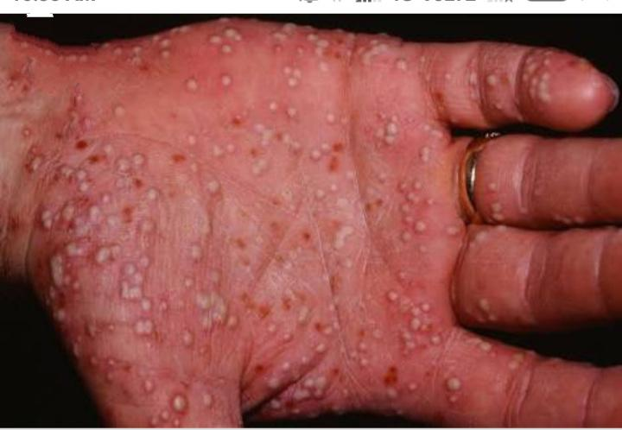
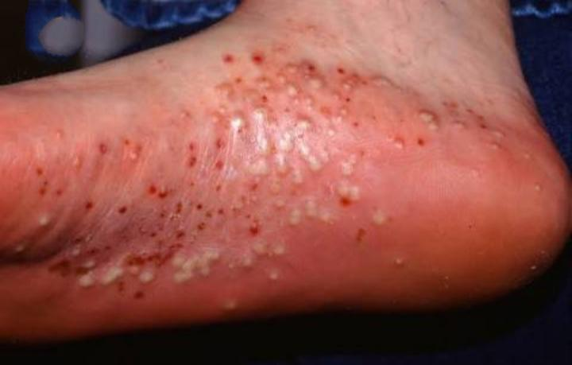

Slide 13
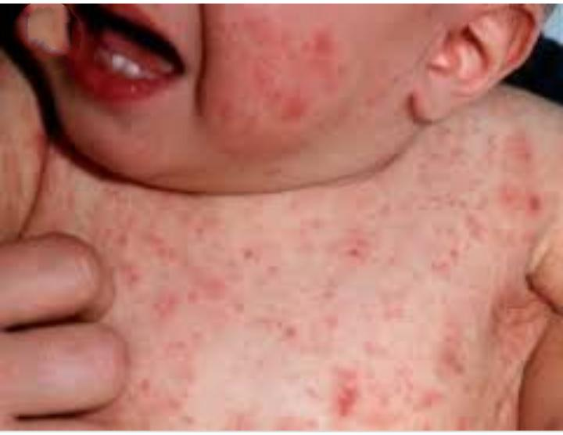

Slide 14
LABORATORY TESTS
Microscopic demonstration of the organism, feces, or
eggs: a drop of mineral oil may be placed over the
suspected lesion before removal; the scrapings are
transferred directly to a glass slide; a drop of potassium
hydroxide is added and a cover slip is applied.
▪ Skin biopsy is rarely necessary to make the diagnosis.

Slide 15
TREATMENT
5 percent permethrin cream
25 percent benzyl benzoate lotion
10 percent sulfur ointment
10 percent crotamiton cream
1 percent lindane lotion

Slide 16
antihistamines, such as Benadryl (diphenhydramine) or pramoxine lotion to help control the itching
antibiotics to kill any infections that develop as a result of constantly scratching your skin
steroid creams to relieve swelling and itching

Slide 17
Scabies Control
Educate patient about personal hygiene, including handwashing
Increase awareness and surveillance for scabies
Instruct patient to bath thoroughly, scrubbing the involved areas with a brush.
Educate other members of the family.
All members of the family should be treated on the same day

