Slide 1
Continuation of Heath care delivery
Hemin johnson
BGI

Slide 2
Model

Slide 3
The model
A number of models have been developed for delivery of health care services. One of the simplest models is:-
The inputs are the health status or health problems of the community. They represents the health needs & health demands of the community. Resources will be limited to meet the many health needs.

Slide 4
The health care services are designed to meet the health needs of the community through the use available knowledge & resources. The services provided should be comprehensive & community based. The resources must be distributed according to the needs of the community.

Slide 5
The health care system Is intended to deliver their health care services.
The final outcome or the output is the changed health status or improved health status of the community which is expressed in terms of lives saved, Death, diseases prevented, cases treated.
Models such as these are being employed for improving health care services.

Slide 6
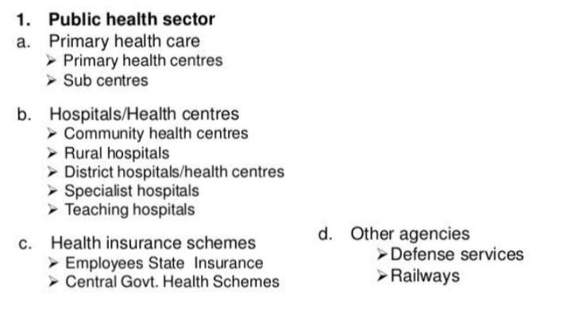
Health care systems

Slide 7
Public health sector
Primary health care in India
In 1977,the government of India launched a rural health scheme, based on the principle of ‘ placing people‘s health in people’s hands’.
keeping in view the wHO goal of ‘ health for all’s by 2000 AD, the government of India evolved a national health policy based on primary care health care approach.
It was approved by parliament in 1983.

Slide 8
Functions of pHC
Medical care.
MCH, family planning & welfare.
School health services.
Improvement in environmental sanitation.
Control & surveillance of communicable disease.
Health education.
Referral services.

Slide 9
Village level
* one of the basic point of primary health care is universal coverage & equitable distribution of health resources.
That is health care must penetrate into fartest reaches of rural areas,
To implement this policy at village level, the following schemes are in operation:-village health guides, training of local daisy, anganwadi worker.

Slide 10
Sub centre level
*The sub centre is the peripheral outpost of the existing health system in rural areas.
There are being established on the basis of one sub- centre for every 5000population in general.
Each sub centre is manned by one male, one female multipurpose health worker.
At present the functions are limited to mother, child health care, family planning & immunization.
It is also proposed to extend the facilities at all sub centres.

Slide 11
Services provided by sub centres:-
Maternal & child health services.
Family planning & welfare services.
Immunization services.
Health education.
Training & supervision of indigenous dais.
Maintenance of sub centres:-
*financial aid or support for most of the centers is made by union ministry of health & family welfare. Rest of the centers are assisted by the state government.

Slide 12
Staffing pattern PHC.
Multipurpose female health worker -1
Multipurpose male health worker-1
Voluntary / part time worker – 1
Total -3.

Slide 13
Hospitals/ health centers
Community health centers.
Each block has one community health center covering a population of 80,000-1, 20,000population.
The services are rendered by a team of specialists, nurses, & other personnel.
Each CHC has 3-4 primary health centers.
CHC Works as a referral centre for PHC ‘s of the area. It is managed by 4 specialist doctors. At present there are 3215 CHC. (2005).

Slide 14
Staffing of CHC’s
*Doctors-4
*nurses-7
Dresser-1
Pharmacist -1
Laboratory assistant, dhobhi ,gardener,ayah,servant-1
Ward boy-2
Cleaning worker-3
Total – 25.

Slide 15
Functions of CHC’s
* provides all preventive & curative health services.
Providing speciality services.
Caring & supervision of concerned PHC’s.
Referring patient to teaching hospitals & district hospitals.
Providing reproductive & child health programs.
Implementation of all national health programs & participations.

Slide 16
Hospitals
Apart from the primary health centres, the present organization of health services of the government sector consists of rural hospitals, subdivisional hospitals, district hospitals, specialist hospitals & teaching institutions.
Rural hospitals
District hospitals
Specialist hospitals
Teaching hospitals.

Slide 17
Rural hospitals:-
It is now proposed to upgrade the rural dispensaries to primary health centres. At Present a good number of PHC’S are located at subdivisional headquarters which also have hospitals. Such PHC’S may be shifted to the interior rural areas. This centres will have an epidemiological wing attached to them.

Slide 18
District hospitals:-
These are proposals to convert the district hospital into district health centre. A hospital service provided are mostly curative, preventive, promotive all integrated. The health team in a health centre is a optimum of medical & paramedical workers. ( doctors, compounders,, nurses etc.

Slide 19
Health insurance
There is no universal health insurance in India. Health insurance is at present limited to industrial workers& their families. The central government employees are also covered by the health insurance, under the banner “ Central govt. Health scheme.

Slide 20
Employees state insurance scheme.
* the ESI scheme, introduced by an act of parliament in 1948,is a unique piece of social legislation in India. It has introduced for the first time in India the principle of contribution by the employer & employee. The act provides For medical care in cash & kind, benefits in the sickness, maternity, employment injury, pension.

Slide 21
Central government health scheme
The central government health scheme for the central government employees was first introduced in new Delhi in 1954,to provide comprehensive medical care to employees. The scheme is based on the principle of cooperative effort by the employee & the employer, to the mutual advantage of both.

Slide 22
Question blog?
Explain the health services:- PHC, CHC’S?
Define the health insurance ?

