Slide 1
IMMUNIZATION
TINTU MARY ABRAHAM
VICE PRINCIPAL
BGI
1

Slide 2
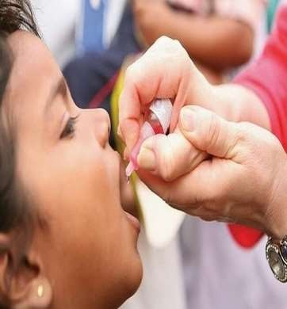
OBJECTIVES
To study what is Immunization,history, various schdedules and programmes .
To study about passive immunization in VPD
TO study how to describe a vaccine
How to calculate vaccine requirement
2

Slide 3
IMMUNISATION
Immunization is the
process inducing providing
of artificially
immunity or
protection
from disease.
3

Slide 4
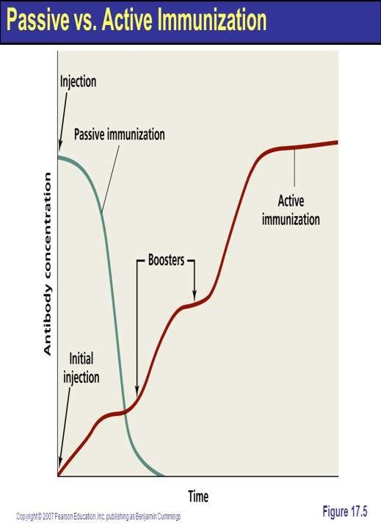
Active is the
immunization process of
stimulating the body to produce antibody
and other immune
through
responses
administration of a vaccine or toxoid.
.
4

Slide 5
Passive immunization is provision of temporary immunity by administration of preformed antibodies derived from humans or animals
5

Slide 6
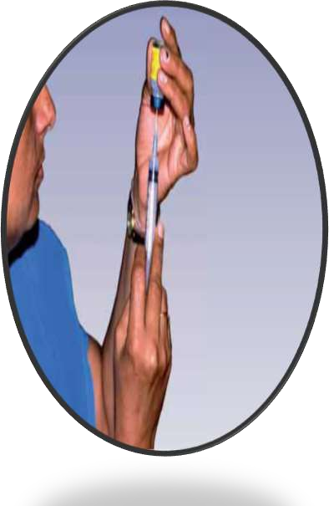
Vaccine
Term derive from “vaccae=cow”.
So immunization agent is known as vaccine.
Vaccine is biological designed specific
a immuno- substance
to produce protection
against a given disease.

Slide 7
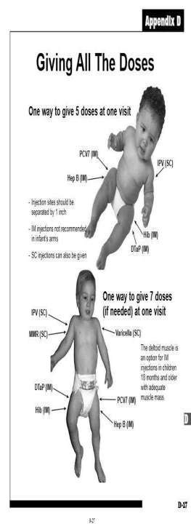
Type of vaccine
Live vaccine.
Inactivated or killed vaccine. 3.SUB UNIT VACCINES
Toxoids .
Protein vaccine
C.RECOMBINANT protein vaccin D.Polysaccharide-based vaccines E.Conjugated vaccine 4.Combination
e

Slide 8
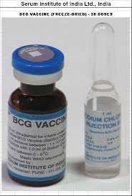
LIVE VACCINE-
Antigen in vaccine is live but attenuated.
Since antigen are live,they multiply in body after administration so stimulus is more.
Generally given in single dose. E.g.-BCG, OPV,MMR, YELLOW FEVER

Slide 9
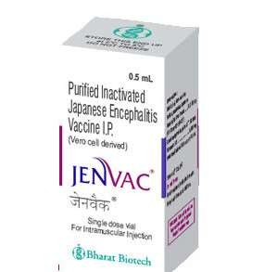
KILLED VACCINE-
Organism are inactivated or killed by heat or chemical.
They are given by multiple doses.
Immunity last shorter than live vaccine.
E.g.-JE VACCINE, ANTIRABIES VACCINE, INFLUENZA KILLED VACCINE

Slide 10
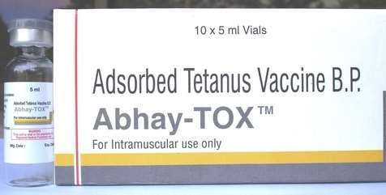
TOXOID-
They are modified toxins.
Toxins are detoxicated They are required in multiple doses.
E.g.- tetanus toxoid, diptheria toxoid

Slide 11
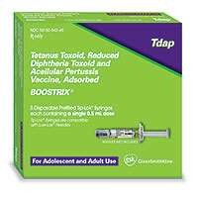
Protein vaccine
Proteins can be purified from in vitro culture of a Pathogenic micro-organism

Slide 12
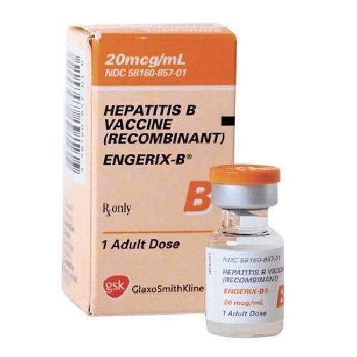
RECOMBINANT PROTEIN VACCINE

Slide 13
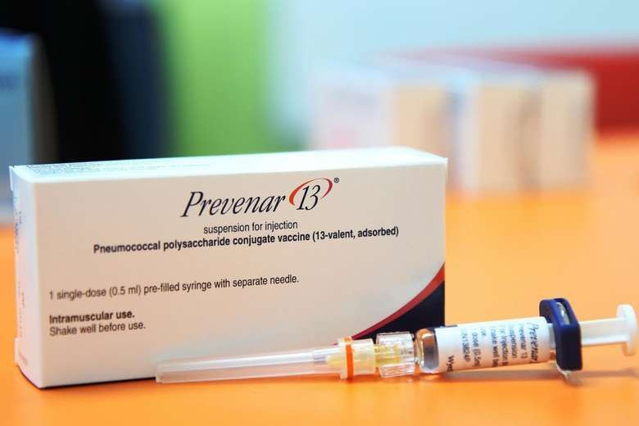
POLYSACCHARIDE-BASED VACCINES

Slide 14
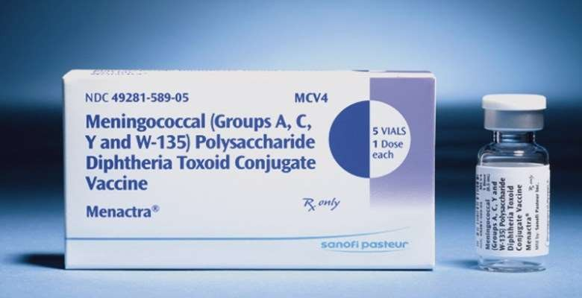
CONJUGATED VACCINE

Slide 15
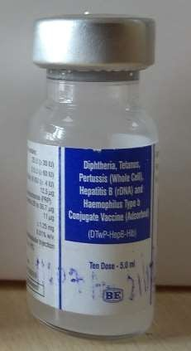
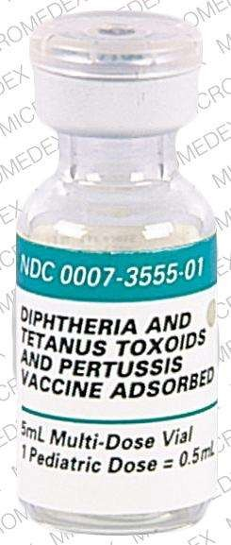
COMBINATION VACCINE-
They are so called because the preparation contains more than one antigen.
They also called mixed vaccine.
E.g.- Easy Five ( penta valent ), DPT
, DT, MMR

Slide 16
Milstone in vaccination
1798 - Smallpox vaccine 1885 - Rabies vaccine 1897 - Cholera vaccine 1921 - BCG

Slide 17
Milstone in vaccination
1923 - Diphtheria Toxoid 1926 - Pertussis vaccine 1927 - Tetanus toxoid 1937 - Influenza vaccine

Slide 18
Milstone in vaccination
1935 - Yellow fever vaccine (17 D) 1949 - Mumps vaccine
1954 - Salk's Polio vaccine
1957 - Sabin live oral Polio vaccine

Slide 19
Milstone in vaccination
1960 - Measles vaccine 1962 - Rubella vaccine
1968 - Type C meningococcus vaccine 1971 - Type A meningococcus vaccine

Slide 20
Milstone in vaccination
1980- smallpox declared eradicated from the world.
1981- meningococcal polysaccharide vaccine, group A,C,Y W135 combined ( Menomune ).
1982- hepatitis B vaccine.
1983- pneumococcal vaccine 23 valent. 1988- worldwide polio eradication initiative launched.

Slide 21
Milstone in vaccination
1990- the vaccine adverse reporting system ( VAERS ), a national programme monitoring the safety of vaccine established.
1991- hepatitis B vaccine recommended for all infant.
1991- acellular pertusis vaccine licensed for use in older children aged 15 month to 6 year.
1993- JE vaccine.
2003- first adult immunisation schedule introduced.

Slide 22
Milstone in vaccination
2004- Pediarix, a vaccine that combines the DTaP, IPV & Hep B vaccines, into one shot , is approved.
2006- Gardasil, the first HPV vaccine is approved.
2008- Rotarix, a two dose rotavirus vaccine is approved.
2009- influenza- A ( H1N1 ) Vaccine approved.

Slide 23
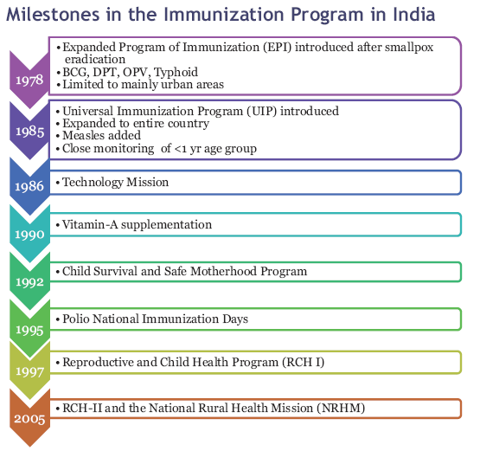

Slide 24
Expanded Program on Immunisation
WHO launch a global immunization program, known as Expanded Program on Immunization (EPI) in May 1974.
To protect all children of the world against six vaccine-preventable diseases, namely - diphtheria, whooping cough, tetanus, polio, tuberculosis and measles by the year 2000.
EPI was launched in India in January 1978 .
24

Slide 25
Universal Immunisation Programme
The Indian version, the Universal Immunization Programme, was launched on November 19, 1985.
The National Health Policy aimed at achieving universal immunization coverage of the eligible population by 1990.
25

Slide 26
NATIONAL IMMUNISATION SCHEDULE VACCINE WHEN TO GIVE
For infants
BCG
At birth or as early as possible till one year of age
Hepatitis B
At birth or as early as possible within 24 hour
OPV 0
At birth or as early as possible within the first 15 days
26

Slide 27
NATIONAL IMMUNIZATION SCHEDULE
OPV 1,2 & 3 | At 6 weeks , 10 weeks & 14 week
ROTA VIRUS 1,2&3 | At 6 weeks , 10 weeks & 14 week
PENTAVALENT 1,2 & 3 | At 6 weeks , 10 weeks & 14 week
FRACTIONAL- IPV 1&2 | At 6 weeks & 14 week
MEASLES AND RUBELLA 1 | 9 completed months -12 month ( given up to 5 years if not received at 9-12 month age)
JAPENESE ENCEPHALITIS 1 | 9-12months
Vitamin A ( 1st dose ) | At 9 month with measles
27

Slide 28
NATIONAL IMMUNISATION SCHEDULE
For children | When to given
DPT booster | 16-24 month
OPV Booster | 16-24 month
Measles and Rubella 2 | 16-24 month
Japanese Encephalitis 2 | 16-24 month with DPT / OPV Booster
Vitamin A | 16 month with DPT/OPV booster. Then one dose every 6 month up to the age of 5 year
DPT booster | 5-6 years
TT | 10 years & 16 years

Slide 29
NATIONAL IMMUNISATION SCHEDULE
FOR PREGNANT WOMEN TT-1
TT-2
TT- Booster
Early in pregnancy 4 weeks after TT-1
If received 2 TT doses in a pregnancy within the last years

Slide 30
IAP SCHEDULE
Birth - 15 days
BCG + OPV (zero dose) +HepB1
6 weeks - 8 weeks
OPV1 +IPV1 + DPT1+ HepB2 + Hib1 +
Rotavirus1 + PCV1
OPV2 + IPV2 + DPT2+ Hib2 + Rotavirus2 + PCV2
OPV3 + IPV3 + DPT3 + Hib3 + Rotavirus3# + PCV3
HepB3 + OPV1
Measles+OPV2
10 weeks- 12 weeks
14 weeks - 16 weeks
6 months
9months (complete d)

Slide 31
IAP SCHEDULE
12 months
15 months
18 months
Hepatitis A1
MMR1 + Varicella + PCV booster
OPV4 + IPV booster1 + DPT*booster1 + Hib booster1 + Hepatitis A2
Typhoid1 (give repeat shots every 3 years)
OPV5 + DPT* booster2
+MMR2^ + Varicella2$$
Tdap/Td (Every 10 years then
give Td)+ HPV**
2 years
5 years
10 - 12 years

Slide 32
Passive immunization in VPD
Passive immunization is a short-term expedient useful only when exposure to infection has just occurred or is imminent within the next few days. The duration of immunity induced is short and variable (1-6 weeks).

Slide 33
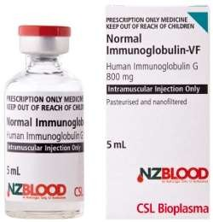
Passive immunization in VPD
Three types of preparations are available for passive immunity-
Normal human immunoglobulin.
Specific (hyperimmune) human immunoglobulin. Antisera or anti-toxins.

Slide 34
Passive immunization is applied in following vaccine preventable disease-
Diphtheria,
Tetanus, Hepatitis B Rabies
& Measles.

Slide 35
DIPTHERIA ANTITIOXIN-
DOSE:
Prophylactic: 500 to 2000 units by subcutaneous or intramuscular injection;
Therapeutic: 10,000 to 30,000 units by
intramuscular injection or 40,000 to 100,000 units by intravenous injection in 2 divided doses with an interval of 12 to 24 hours.

Slide 36
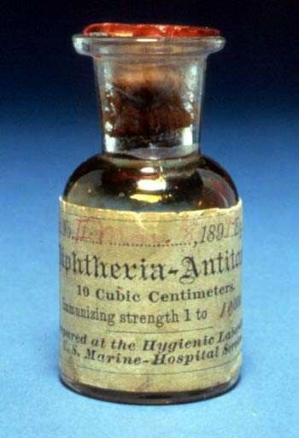
Passive Immunisation – Immunoglobulins
1. ADS of horse origin.
2. ADS of human origin.

Slide 37
Dosage of antitoxin (equine)
Duration of disease | 48 hours
Lesions | Throat | Larynx
Dose | 20 000 | 20 000
(I.U.) | – 40000 | – 40000
Must be used only after sensitivity test.
37

Slide 38
Dosage of antitoxin (equine)
Duration of disease | Over 48 hours
Lesions | Membrane in naso- pharynx | Swelling in neck | Extensive disease > 3 days
Dose | 40000 | 80000 | 80000
(I.U.) | – 60000 | – 120000 | – 120000
Must be used only after sensitivity test.
38

Slide 39
Antitoxin Treatment – human
Dose: 0.6 ml/kg body weight Intramuscular (Available as 2ml vial with 300 mg Globulins).
Advantage over ADS (horse origin):
Hypersensitivity absent.
Longer protection.
39

Slide 40
MEASLES IMMUNOGLOBULIN (HUMAN )
DOSE- recommended by WHO is 0.25 ml per kg of body weight. It should be given within 3-4 days of exposure.
The person passively immunized should be given live measles vaccine 8-12 weeks later.
40

Slide 41
HEPATITIS B IMMUNOGLOBIN-
The recommended dose is 0.05 to 0.07 ml/kg of body weight ; two doses should be given 30 days apart . HBIG provides short-term passive protection which lasts approximately 3 months . Since the median incubation period is said to be lower than 100 days , two doses of HBIG given one month apart should suffice.
41

Slide 42
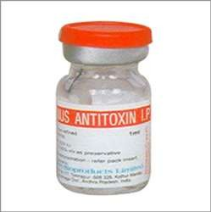
TETANUS IMMUNOGLOBIN
Dose – 250 unit for prophylaxis
3000-6000 for therapeutic
42

Slide 43
HOW TO DESCRIBE A VACCINE
whenever one describe a vaccine it must be done under the following heads
Type
Content Dose
Time of administration
No of doses including boosters
53

Slide 44
HOW TO DESCRIBE A VACCINE
Diluent if any
Time after reconstitution Efficacy
Storage
Side effects contraindications
54

Slide 45
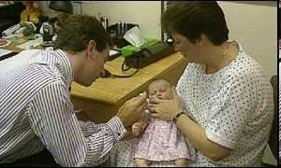
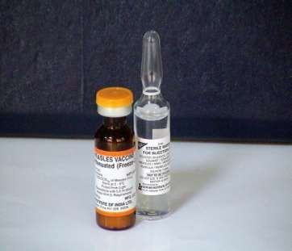
MEASLES VACCINE
Freezed dried vaccine contains live attenuated virus 1000 T.C.I.D.₅₀;
Stored at 2-8ºC.
Dose → 0.5 ml; Route → Subcutaneous.
55

Slide 46
MEASLES VACCINE
Time of administration → 9 months in India.
According to W.H.O if child is malnourished,
1st dose is b/w 6-8 months; 2nd dose after 1 year.
Efficacy of Vaccine – 95%if given after one year. At nine months -85%
Duration of immunity– Lifelong.
56

Slide 47
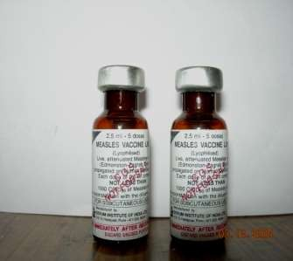
Measles vaccine
It is freezed dried vaccine
Has to be reconstituted with
distilled water 8.Reconstituted vaccine
must be
used as early as possible

Slide 48
Measles vaccine
It has shell life for 2 years
Must be stored between
2-8 degree centirgade

Slide 49
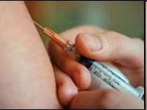
MEASLES VACCINE
Recent W.H.O. recommendation – 1st dose of measles 9 months.
2nd dose of M.M.R. – 15 months.
This vaccine may also be given to contacting person.
59

Slide 50
Complications of vaccine
Fever
Rash
Rarely S.S.P.E
T.S.S

Slide 51
CONTRAINDICATIONS TO MEASLES VACCINE
1.Impaired cell-mediated immunity. 2.Convulsions.
3.Patient on steroids. 4.Pregnancy.
61

Slide 52
CONTRAINDICATIONS TO MEASLES VACCINE
Active T.B.
Acute infectious disease. 7.Generalized allergy.
62

Slide 53
How to calculate vaccine requirement
There are two ways to calculate vaccine requirement-
based on real number of beneficiaries in community.
based on , Birth Rate and IMR.
63

Slide 54
Method 1-
count the total number of beneficiaries, like infant, pregnant mother etc.
multiply it with total number of dose of vaccine to be given.
now multiply it with wastage factor for different vaccines
64

Slide 55
Eg- if there are 100 infant. Number of doses of BCG require will be
100× 1 × 1.33= 133 doses
Since vial of BCG come in doses of 10.
So needed vial will be= 133/10= 13.3 i.e. 14
65

Slide 56
Method 2- if we know the Birth Rate & IMR.
Example- if birth rate is 22/1000 population & calculation is required for sub centre which cater 5000 population.
total number of pregnant women = 22×5
=110
10% wastage factor will be added for abortion so total number of pregnant lady will be-
= 110+ 11=121
66

Slide 57
Now for infant we will have to consider BR as live birth. So number of infant = 110
Since IMR = 34 /1000 live birth
So total infant will be= 110-4= 106
If we want to calculate dose of penta =
= 106×3×1.18(wf)
=376
So total number of vial for Penta- 376/10= 38
67

Slide 58
WASTAGE MULTIPLICATION FACTOR
 | NO. OF DOSES | WMF
HEP B | 1 | 1.11
BCG | 1 | 2
DPT | 2 | 1.11
OPV | 3+2 BOOSTER | 1.11
ROTA VIRUS | 3 | 1.33
IPV | 2 | 1.11
PENTAVALENT | 3 | 1.11
MR | 2 | 1.33
PCV | 3 | 1.11
TT | 2 | 1.11
JE | 2 | 1.33
SYRINGES | AS PER REQUIREMENT | 1.11
DR. HAR
IVANSH CHOPRA (harichop@gmai
l.com)
68

Slide 59
MCQ
Q. 1. Name the vaccine which was first discovered In the world
Rabies
Plaque
Small pox
Chicken pox
69

Slide 60
MCQ
Q.2.in which year small pox vaccine was discovered
1. 1798
2. 1898
3. 1998
4. 1800
70

Slide 61
MCQ
Q.3 While calculating vaccine requirement, The wastage multiplication factor is
1. 1
2. 1.33
3. 1.5
4. Is different for different vaccines
71

Slide 62
Q.4 the total number of pregnant women in calculation of vaccine requirement by enumration is found out by using a mutiplication factor of
1. 1.33
2. 1.5
3. 2
4. 0.1
72

Slide 63
MCQ
q.5 the dose of immunoglobulin in the prevention of measles is
1 ml/kg
1.5ml/kg
0.5ml/kg
4. 0.25ml/kg
73

Slide 64
74

