Slide 1
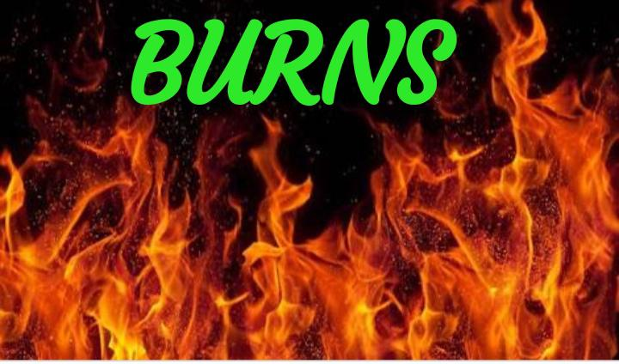

Slide 2
DEFINITION
Burn is a type of injury to skin, or other tissues, caused by heat, cold, electricity, chemicals, friction, or radiation.^{[4]}

Slide 3
INCIDENCE
Burns can occur at all age groups and socio economic groups.
▪ Approximately,100,000 are hospitalised and 70,000 people required extensive care services and an estimated 12,000 of these people die anually as a direct result of burns.

Slide 4
TYPES OF BURN
BASED ON ETIOLOGY
Chemical burns
Thermal burns
Electrical burns
Radiation burns
Smoke and inhalation burns

Slide 5
Chemical burns
Chemical burns are caused by contact with strong acids, alkalis or organic compound.
It can be result from contact with certain household cleansing agents and various chemical used in industry and agriculture.

Slide 6
Thermal burns
Thermal burns are caused by exposure to or contact with flame, hot liquids, semi liquids (e.g steam),semisolids (e.g tar) or hot objects.
E.g residential fires, explosive automobile accidents, cooking accident.

Slide 7
Electrical burns
It is caused by heat, that is generated by the electrical energy as it passess through the body
Direct damage to nerve and vessels causing tissue anoxia and death can also occur.
It can result from contact with exposed or faulty wiring or high voltage power lines.

Slide 8
Radiation burns
This are least common types of burn injury and are caused by exposure to a radiation source.
This types of injuries have been associated with nuclear radiation accidents, the use of ionising radiation in industry and therapeutic radiation.
Sun burn from prolonged exposure to UV rays is also considered to be a radiation burns.

Slide 9
Smoke and inhalation burns
It results from the inhalation of hot air or noxious chemical and caused damage to the tissues of the respiratory tract.
carbon monoxide poisoning : CO poisoning and asphyxiation account for the majority of death at a fire scene.
It is produced by the incomplete combustion of burning material

Slide 10
Burns are classified as first-, second-, third-degree, or fourth-degree depending on how deeply and severely they penetrate the skin's surface.
CLASSIFICATION

Slide 11
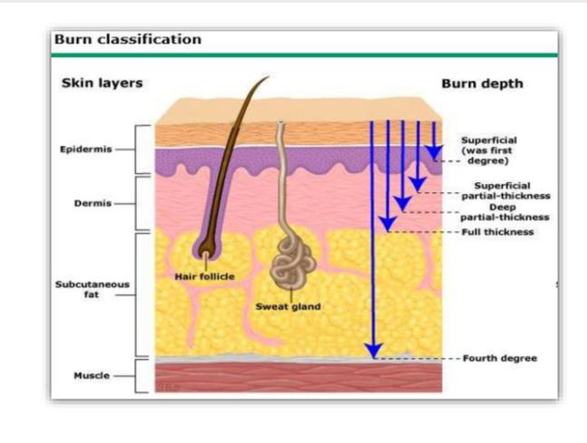

Slide 12
First-degree (superficial) burns
First-degree burns affect only the outer layer of skin, the epidermis. The burn site is red, painful, dry, and with no blisters. Mild sunburn is an example. Long-term tissue damage is rare and often consists of an increase or decrease in the skin color.

Slide 13
Second-degree (partial thickness) burns
Second-degree burns involve the epidermis and part of the lower layer of skin, the dermis. The burn site looks red, blistered, and may be swollen and painful.

Slide 14
Third-degree (full thickness) burns
Third-degree burns destroy the epidermis and dermis. They may go into the innermost layer of skin, the subcutaneous tissue. The burn site may look white or blackened and charred.

Slide 15
Fourth-degree burns
Fourth-degree burns go through both layers of the skin and underlying tissue as well as deeper tissue, possibly involving muscle and bone. There is no feeling in the area since the nerve endings are destroyed.

Slide 16
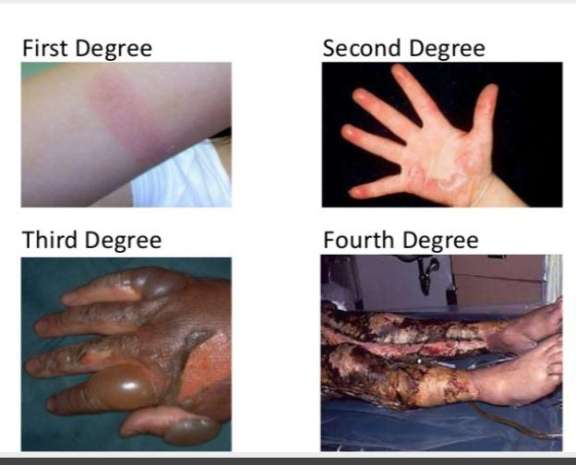

Slide 17
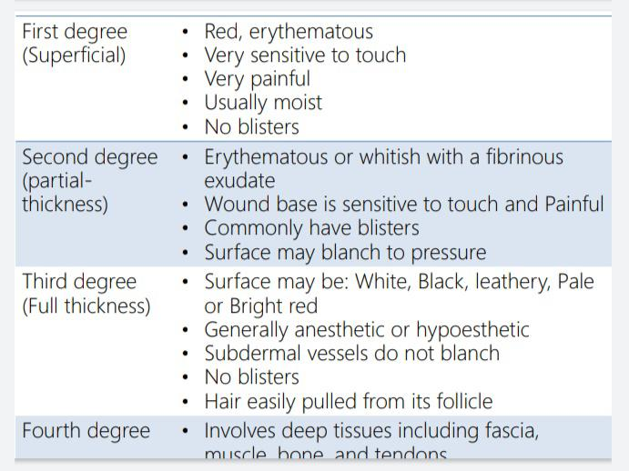

Slide 18
Assessment of The Burn Wound
Extent of TBSA (total body surface area) injured
Rule of nine
Palm method
The Lund and Browder method

Slide 19
Rule of nine
It is the quick way to estimate the extent of burns.
The system assigns percentages in multiples of nine to major body surfaces.

Slide 20
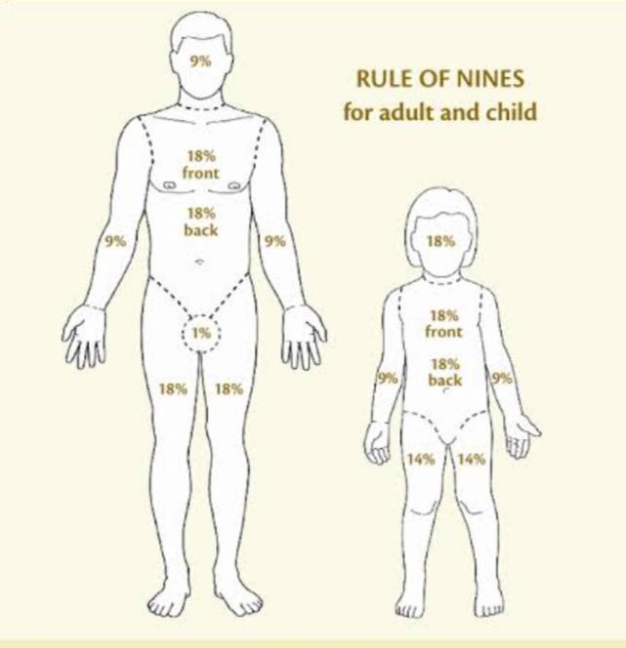

Slide 22
Lund and Browder method
The more precise method of estimating the extent of a burn in the Lund and Browder method, which recognise that the percentage of the surface area of various anatomical parts especially the head and legs, changes with growth

Slide 23
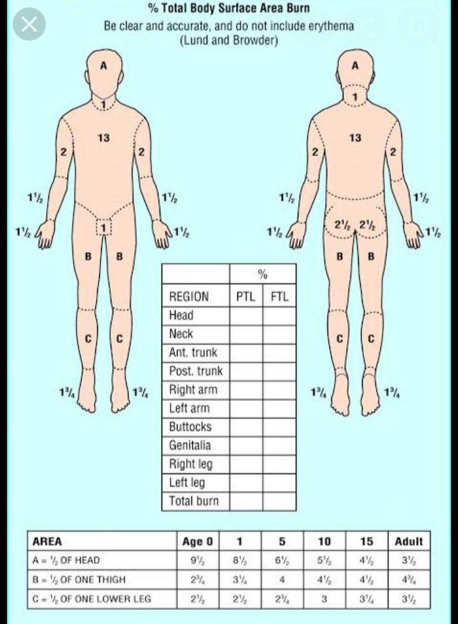

Slide 24
PATHOPHYSIOLOGY

Slide 26
CLINICAL MANIFESTATIONS
Cardiovascular system alteration
▪ Decreased cardiac output
▪ Decreased blood pressure
▪ Decreased in platelet
▪ Prolonged clotting and prothrombin time
▪ Weak pulse

Slide 27
Pulmonary alteration
Increased respiratory rate
▪ Decreased oxygen saturation
▪ Hypoxia
▪ Dyspnea
▪ Increased work of breathing and eventually
cyanosis

Slide 28
Fluid & electrolyte alteration
Hypovolemia
▪ Hyponatremia
▪ Hypernatremia
▪ Hyperkalemia
▪ Less urine output
▪ Dry mucus membrane poor skin turgor

Slide 29
Renal alteration
Destruction of RBC result in free hemoglobin
in urine
▪ Decreased in urine output
▪ Acute tubular necrosis
▪ Increased in urea level
▪ Renal failure

Slide 30
Gastrointestinal alteration
Decreased or absence of bowel sound stool or
flatus
▪ Nausea, vomiting and abdominal distention
▪ Paralytic ileus and curling ulcers

Slide 31
Immunologic alteration
Sepsis
▪ Impaired neutrophil function
▪ Reduction in lymphocyte
▪ Resulting in immunosuppression

Slide 32
Psychological response
Psychological and emotional response
▪ Body image and ineffective coping abilities
▪ Isolation
▪ Disbelief
▪ Anxiety
▪ Grief
▪ Depression

Slide 33
Pain response
Pain
▪ Clinical response to pain may include an
increased in BP, heart rate, respiratory rate
with dilated pupils and rigid muscle tone

Slide 34
Diagnostic evaluations
History collection
Physical examination
ABG analysis
Na, K, Cl
CBC
Prothrombin time
Bleeding time and clotting time
RBS, urea and creatinine , ECG,chest Xray etc

