Slide 1
Hemin Johnson
BGI

Slide 19
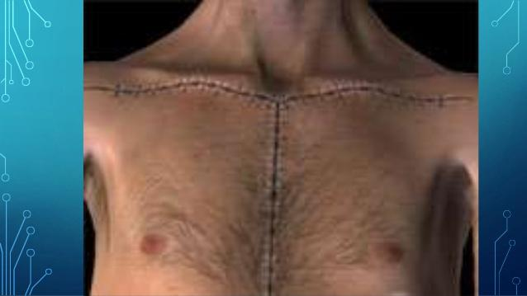

Slide 21
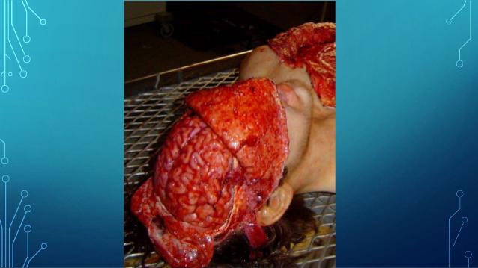

Slide 23
Question blog ?
Define autopsy?
Enlist the classification of autopsy ?
What are the steps in the physical examination ?

