Slide 1
Vital statistics
Hemin johnson
BGI

Slide 2
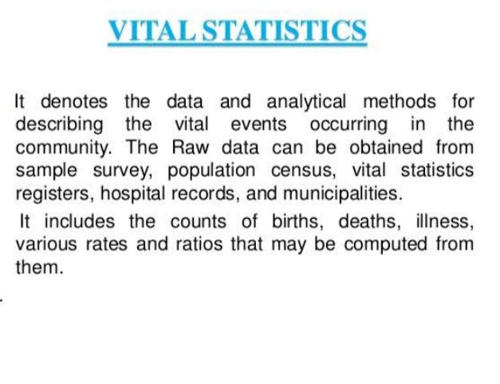

Slide 3


Slide 4
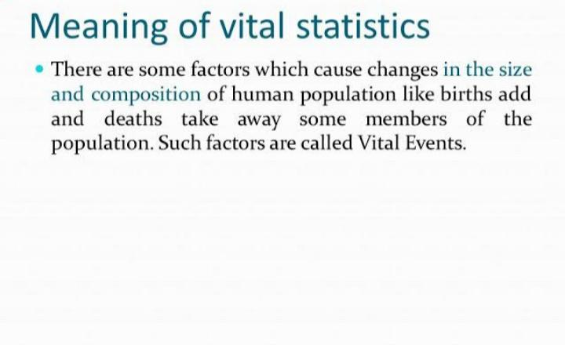

Slide 5
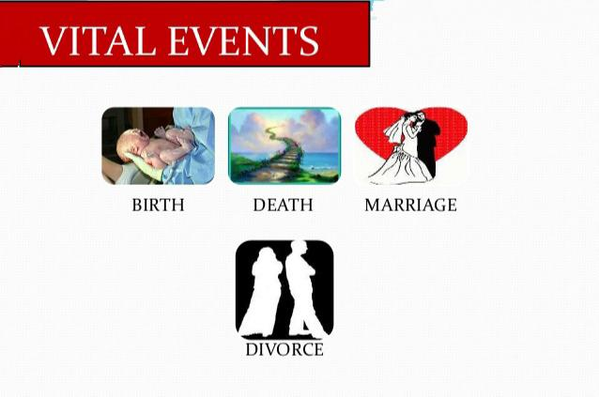

Slide 6
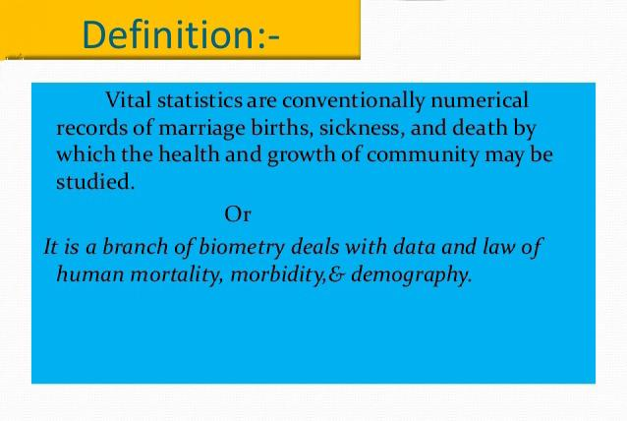

Slide 7


Slide 8
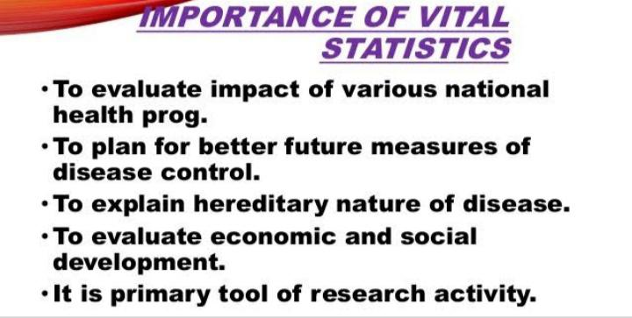

Slide 9
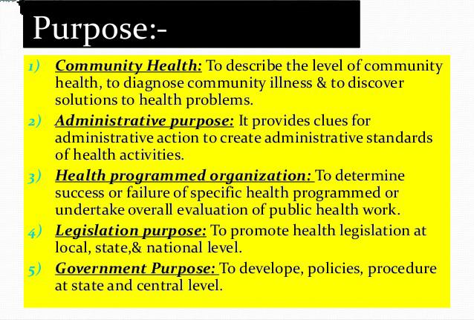

Slide 10
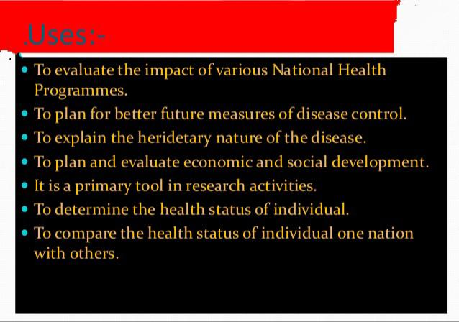

Slide 11
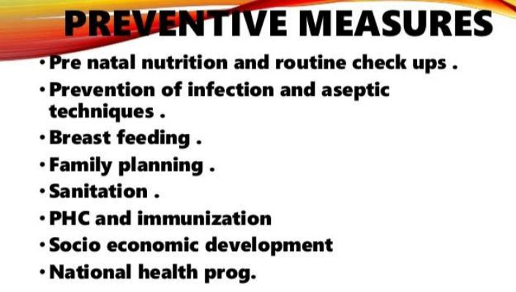

Slide 12
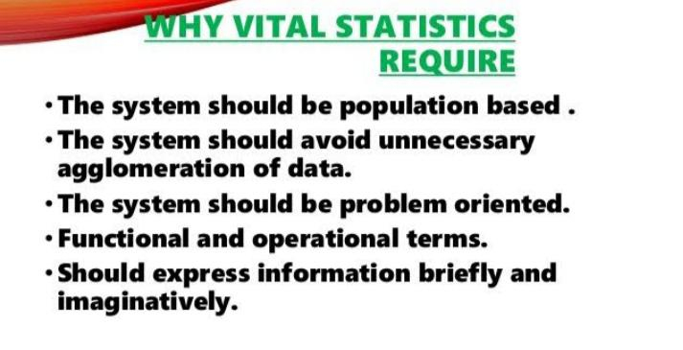

Slide 13
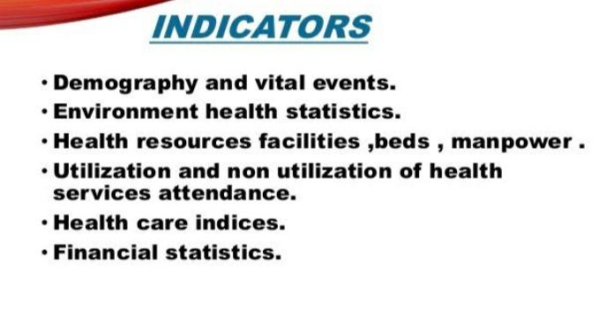

Slide 14
Question Blog?
Definition of vital statistics?
Why is the vital statistics required?
List out the purpose & importance of vital statistics?

