Slide 2
DEFINITION OF PAIN
An unpleasant sensation that can range from mild, localized discomfort to agony. Pain has both physical and emotional components. The physical part of pain results from nerve stimulation.

Slide 3
TYPES OF PAIN
Acute pain.
Chronic pain.
Nociceptive pain.
Neuropathic pain.

Slide 4
Acute pain usually comes on suddenly and is caused by something specific. It is sharp in quality. Acute pain usually does not last longer than six months. It goes away when there is no longer an underlying cause for the pain.
Chronic pain is pain that is ongoing and usually lasts longer than six months. This type of pain can continue even after the injury or illness that caused it has healed or gone away. Pain signals remain active in the nervous system for weeks, months, or years. Some people suffer chronic pain even when there is no past injury or apparent body damage

Slide 5
The categories are pain caused by tissue damage, also called nociceptive pain, and pain caused by nerve damage, also called neuropathic pain. A third category is psychogenic pain, which is pain that is affected by psychological factors.

Slide 13
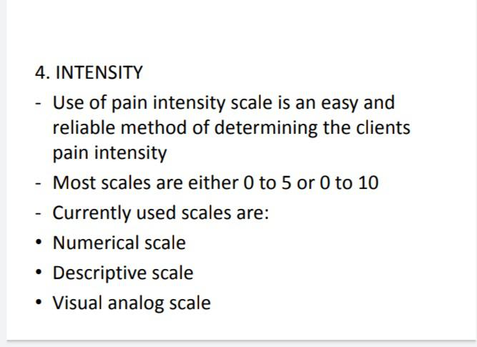

Slide 15
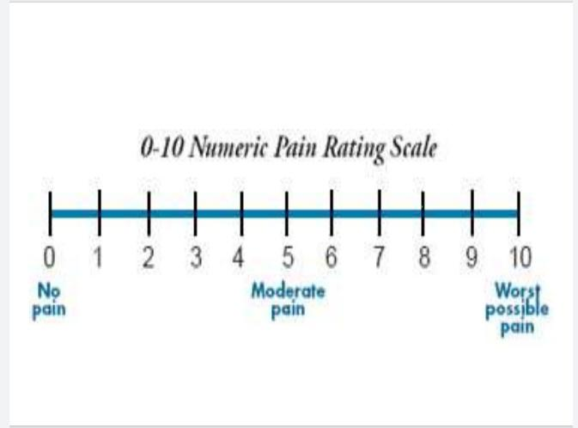

Slide 18
