Slide 1
VENOUS INSUFFICIENCY
Chronic venous insufficiency occurs when your leg veins don’t allow blood to flow back up to your heart. Normally, the valves in your veins make sure that blood flows toward your heart. But when these valves don’t work well, blood can also flow backwards. This can cause blood to collect (pool) in your legs.

Slide 2
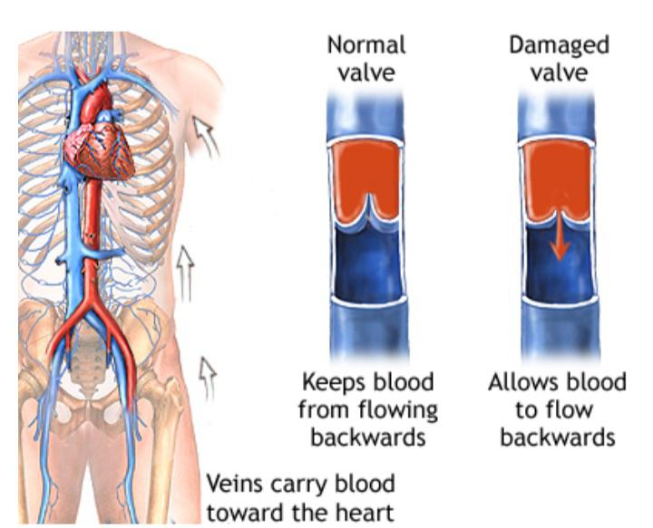

Slide 3
VENOUS ULCER
A venous skin ulcer is a sore on your leg that’s very slow to heal, usually because of weak blood circulation in the limb.
Venous ulcers happen when there’s a break in the skin on your leg, usually around the ankle.

Slide 4
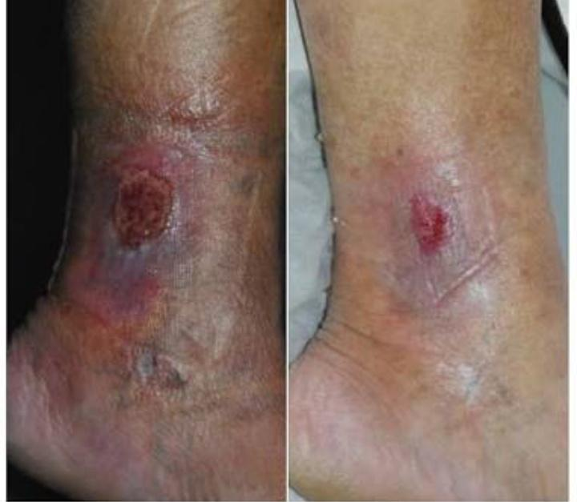

Slide 5
VERICOSE VEIN
Varicose veins, also known as varicoses or varicosities, occur when your veins become enlarged, dilated, and overfilled with blood. Varicose veins typically appear swollen and raised, and have a bluish-purple or red color. They are often painful

Slide 6
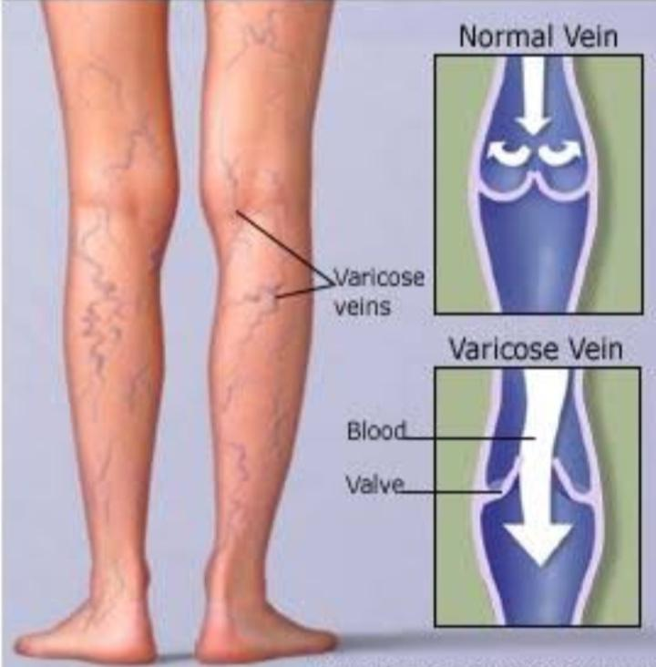

Slide 7
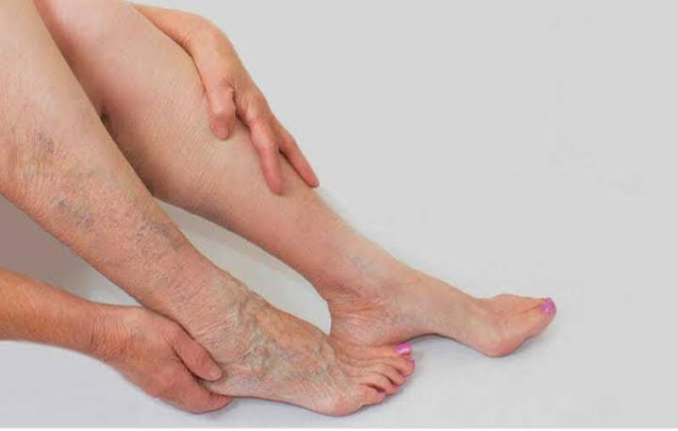

Slide 8
CELLULITIS
Cellulitis is a common and sometimes painful bacterial skin infection. It may first appear as a red, swollen area that feels hot and tender to the touch. The redness and swelling can spread quickly.
It most often affects the skin of the lower legs, although the infection can occur anywhere on a person’s body or face.
Cellulitis usually happens on the surface of the skin, but it may also affect the tissues underneath. The infection can spread to your lymph nodes and bloodstream.

Slide 9
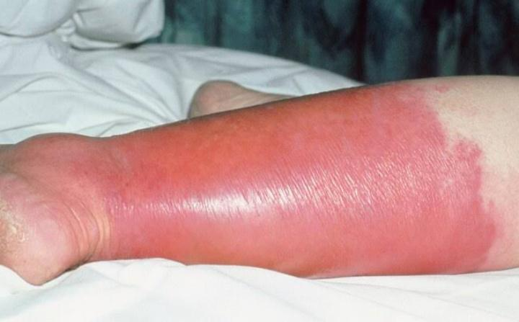

Slide 10
LYMPHANGITIS
Lymphangitis is an inflammation of the lymphatic system, which is a major component of your immune system.
Infectious lymphangitis occurs when bacteria or viruses enter the lymphatic channels. They may enter through a cut or wound, or they may grow from an existing infection.

Slide 11
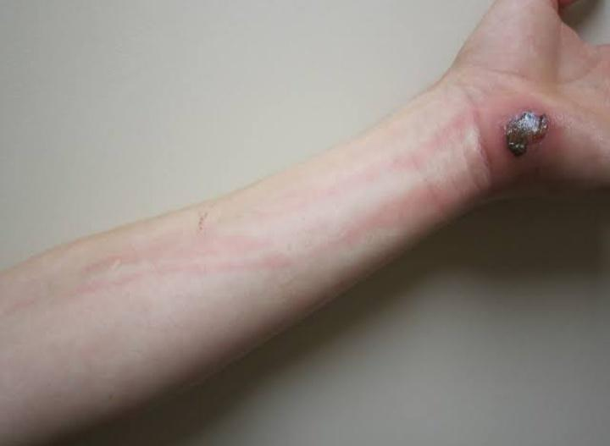

Slide 12
LYMPHADENITIS
Lymphadenitis is an infection of the lymph nodes (also called lymph glands). It is a complication of certain bacterial infections.
Lymphadenitis occurs when the glands become enlarged by swelling (inflammation), often in response to bacteria, viruses, or fungi. The swollen glands are usually found near the site of an infection, tumor, or inflammation.

Slide 13
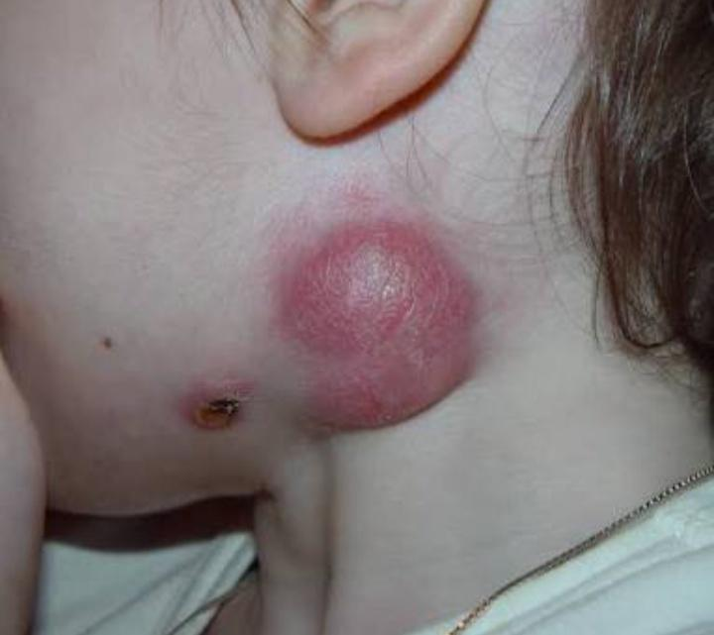

Slide 14
ELEPHANTIASIS
Elephantiasis, also known as lymphatic filariasis, is a very rare condition that’s spread by mosquito.
Lymphatic filariasis impairs the lymphatic system and can lead to the abnormal enlargement of body parts, causing pain, severe disability and social stigma.
Infection occurs when filarial parasites are transmitted to humans through mosquitoes.

Slide 15
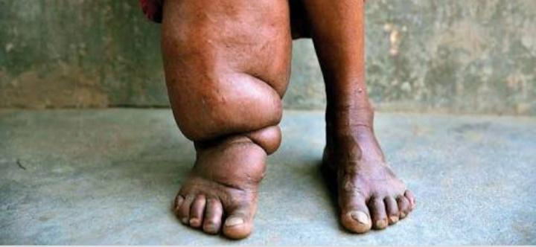

Slide 16
LYMPHEDEMA
Lymphedema refers to swelling that generally occurs in one of your arms or legs. Sometimes both arms or both legs swell.
Lymphedema is most commonly caused by the removal of or damage to your lymph nodes as a part of cancer treatment. It results from a blockage in your lymphatic system, which is part of your immune system. The blockage prevents lymph fluid from draining well, and the fluid buildup leads to swelling.

Slide 17
