Slide 1
CIRCULATORY SYSTEM
SUBJECT : anatomy and physiologY
BY:GOWRI.R
ASSISTANT LECTURER
BANAGALORE GROUP OF INSTITUTION

Slide 2
BLOOD INTRODUCTION:-
Blood, a type of connective tissue .it is a complex mixture of cells, chemicals and fluids.
Blood transports substances through the body and helps in maintain a stable internal environment.
The only fluid tissue in the human body.

Slide 3
PHYSICAL PROPERTIES OF BLOOD
SPECIFIC GRAVITY
WHOLE BLOOD PLASMA | 1.055-1.065 1.024-1.028
VISCOSITY | 5-6 times that of water.
MASS | 6-8% of the body weight
BLOOD VOLUME | 5-6 Ltr
PH | 7.35-7.45
TEMPERATURE | 38*c/102.4`F
COLOUR | Opaque fluid, red in colour.

Slide 4
FUNCTIONS OF BLOOD
RESPIRATION: transport of O2 and CO2.
TRANSPORT: transports hormone, nutrients, metabolic.
EXECUTION OF METABOLIC wastes to the kidney, lungs and skin.
REGULATION: regulation of body temperature by distribution of body heat
DEFENCE against infections( WBCs, antibodies)
MAINTENANCE of acid- base balance.
NUTRITION: transport of absorbed food materials.

Slide 5
COMPOSITION OF BLOOD
FORMED ELEMENTS(40%)
RBC(ERYTHROCYTES)
WBC(LEUKOCYTES)
PLATELETS(THROMBOCYTES)
FLUID MEDIUM that is the plasma(55%)

Slide 6
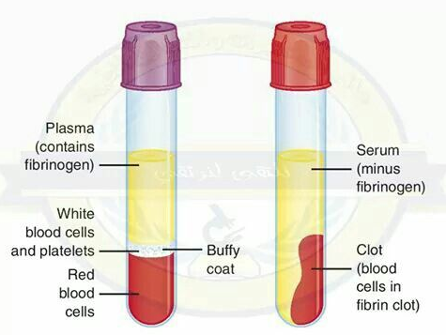
PLASMA
PLASMA IS THE INTERCELLULAR MATRIX OF THE BLOOD .
ALBUMIN:
1.helps buffer the blood.
2.Transport many solutes by binding to them ex:drugs, penicillin, pigments, fatty acid.
GLOBULIN
1.it helps transport solutes.
2.Some involved in clotting.
3.Transport and storage of proteins.
FIBRINOGEN
1.Framework for clotting.
2.Its a clotting protein.
Transferrin :carries iron in blood.
Ferritin: stores iron in liver and marrow

Slide 7
NORMAL VALUES OF BLOOD CELLS
normal range for red blood cell count is 4.5 to 5.5 million cells/mm³ for male and 4 to 5 million cells/mm³ for female .
The life span of RBCs =120 days
Polycythemia blood disorder in which the bone marrow produces too many red blood cells. anemia condition in which the blood doesn't have enough healthy red blood cells.
The normal range for a white blood cell count in a healthy adult is between 4,000 and 11,000 WBCs per microliter.
Leukocytosis an increase in the number of white cells in the blood, especially during an infection . leukopenia decrease number of WBC ‘s.
lifespan of white blood cells =13 to 20 days,
A normal platelet count ranges from 150,000 to 450,000 platelets per microliter of blood. Having more than 450,000 platelets is a condition called thrombocytosis; having less than 150,000 is known as thrombocytopenia.
The average life span of circulating platelets i= 8 to 9 days.

Slide 8
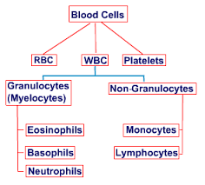
CLASSIFICATION OF BLOOD CELLS

Slide 9
PACKED CELL VOLUME (HEMATOCRIT)
The packed cells volume(PCV) is a measurement of the blood
Proportion of blood that is made up of cells.
Packed cell volume test is also known as haematocrit.
The test is done to diagnose polycythemia , dehydration.
The measurement depends on the number and size of red blood cells. It is normally 40.7%–50.3% for men and 36.1%–44.3% for women.

Slide 10
TERMINOLOGY
HEMOSTASIS : is a process to prevent and stop bleeding.
HEMATOPOIESIS :hematopoiesis is the formation of blood cellular
Components. all cellular components are derived from hematopoietic
Stem cells.
SHORT ANSWER;
1.FUNCTIONS OF BLOOD(5 MARKS)
2.HEMATOSTASIS(2 MARKS)
3.HEMATOPOIESIS(2 MARKS)
4.PHYSICAL PROPERTIES OF BLOOD.(2 MARKS)
5.HEMATOCRIT/PACKED CELL VOLUME.(2 MARKS)
6.PLASMA PROTEINS (5 MARKS)

