Slide 1
Hemin Johnson
BGI

Slide 3
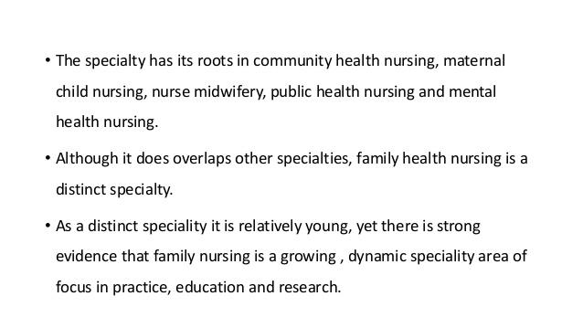

Slide 7
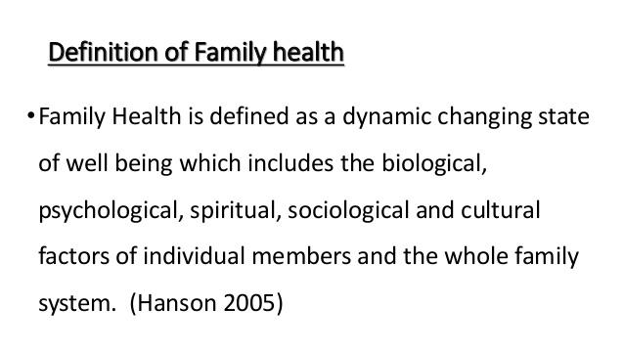

Slide 21
Question blog ?
Define family ?
Definition of family health ?
Enlist the principles of family health services ?

