Slide 1
LYMPH NODE
BY : GOWRI. R
ASST. LECTURER
BGI

Slide 2
LYMPH NODE
1. lymph node are small masses of lymphoid tissues, present in the groups along the courses of lymphatic vessels . They act as a filters removing bacteria and other particulate matters from lymph . Lymphocytes are added to the lymph in these nodes .
2. each group of lymph nodes has a specific area of drainage .
3. each lymph node consist of connective tissue framework and numerous lymphocytes .

Slide 3
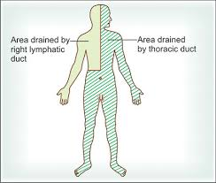
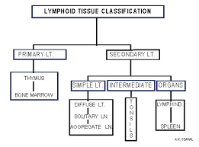
Classification of lymphoid organ and area of body drained in thoracic duct and right lymphatic duct

Slide 4
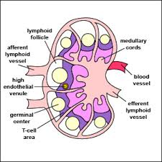
Structure of lymph node
Structure :lymph nodes is bean shaped . Its concave surface is called hilum , through which blood vessels enters and leave the lymph node . Several lymph vessels enter the nodes on its convex surface .
Medulla :in this zone , the lymphocytes are arranged in the form of branching and anastomosing cord . The remaining space within the node is filled by a network of reticular fibers .

Slide 5
Capsule :a lymph node is surrounded by a capsule . The capsule consists mainly of collagen fibers ;elastic fibers and smooth muscle may be present . Just below the capsule is the subcapsular sinus . A number of septa or trabeculae extend into the node has an outer cortex and inner medulla . The cortex does not extend into the hilum .
Cortex :the cortex is made up of densely packed lymphocytes . There are several rounded masses of lymphocytes , called lymphatic follicles or lymphatic nodules . Each nodule has a paler germinal center , surrounded by dark staining , densely packed lymphocytes .
CELLS OF LYMPH NODE:
These cells are predominantly lymphocytes , both B – and T-lymphocytes are present in the lymph nodes . Other cells present in the lymph nodes are macrophages and fibroblasts .

Slide 6
CIRCULATION OF LYMPH THROUGH LYMPH NODE
There are endothelium –lined space called sinuses , within the lymph node . They are as follows :
The subcapsular sinus just beneath the capsule
Cortical sinuses in the cortex
Medullary sinuses in the medulla
afferent lymph vessels reach the convex , outer surface of the lymph node . The lymph reaches the subcapsular sinus , from where the lymph goes to cortical sinuses , then to the medullary sinuses .here they join to form one or two efferent vessels , which comes out of the hilum .

Slide 7
The afferent vessels to a lymph node enters the cortex , while the efferent vessels emerges from the medulla . The sinuses are lined by endothelium . When lymph flows through the lymph node . It comes into contact with the macrophages , which removes bacteria and other particulate matter .
Functions of lymph node
1.lymph node are centers of lymphocytes production . Both B – and T- lymphocytes are produced here by multiplication of pre –existing lymphocytes . These lymphocytes pass into lymph and thus reach the blood stream.

Slide 8
2.Bacteria and other particulate matter are removed from lymph through phagocytosis by macrophages .
3.Plasma cells ( presenting fully mature B- lymphocytes )produce antibodies against invading antigens , while T- lymphocytes attack cell that are ‘foreign’ to the host body .

Slide 9
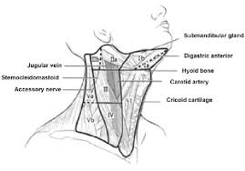
Major lymph nodes of body
There are three sets of lymph nodes , which are clinically important :
Cervical lymph nodes
Axillary lymph node
Inguinal lymph nodes
CERVICAL LYMPH NODES
They are arranged as follows ;
Superficial group
Deep group
Deepest group

Slide 10
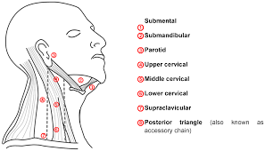
SUPERFICIAL GROUP
The superficial group of cervical nodes consists of :
Buccal and mandibular nodes
Preauricular nodes
Post auricular(mastoid ) nodes
Occipital nodes

Slide 11
DEEP GROUP:
Deep cervical nodes lie along the internal jugular vein , deep sterno cleidomastoid . They are divided into two groups by the intermediate tendon of omohyoid . The superior group lies above omohyoid and is called jugulodigastric node . It receives lymph mainly from palatine tonsil hence also called node of tonsil . The inferior group lies below omohyoid muscle along the jugular vein and is called jugulo- omohyoid node . It receive lymph mainly from tongue , hence also called node of tongue . Submental and submandibular nodes are also included in deep cervical nodes .

Slide 12
DEEPEST GROUP
Deepest group consists of :
Prelaryngeal and pretracheal nodes
Retropharyngeal nodes
Thoracic cavity
Lymph from organ and tissues in the thoracic cavity drains through group of nodes situated in the mediastinum , along large airway , esophagus and chest wall . These ultimately join the thoracic duct . Enlarged mediastinal nodes may compress the bronchi, vessels and nerves lying close to them .

Slide 13
Abdomen and pelvis
Lymph from pelvic and abdominal cavities passes through many lymph nodes before entering the cisterna chyli .
Abdominal and pelvic lymph nodes are situated along the blood vessels suppling the organs and are named accordingly (e,g.,celiac lymph node , superior mesenteric lymph node, inferior mesenteric lymph node ), and close to main arteries (e.g. preaortic lymph node , para –aortic lymph node , internal iliac lymph node , external iliac lymph node , etc,).

Slide 14
Anterior abdominal wall
Superficial lymphatic of anterior abdominal wall drains as follows:
Above the levels of umbilicus they drain into axillary group of lymph nodes .
Below the level of umbilicus they drain into superficial inguinal lymph nodes .
Lower limb
Lymphatics from lower limb are primarily drained by inguinal group of lymph nodes.

Slide 15
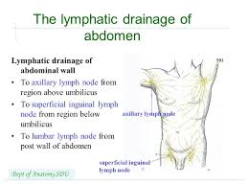
Superficial lymphatics of anterior abdominal wall

