Slide 1
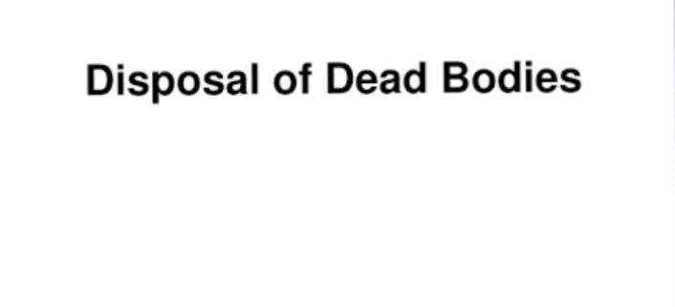
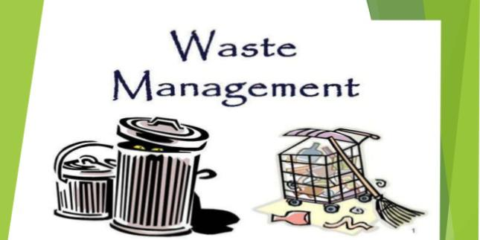
Hemin Johnson
BGI

Slide 2
Disposal of dead bodies
In India nearly 8 million deaths occur annually therefore it is important to consider the method of disposal.
Types mainly are -- * cremation
* burial

Slide 3
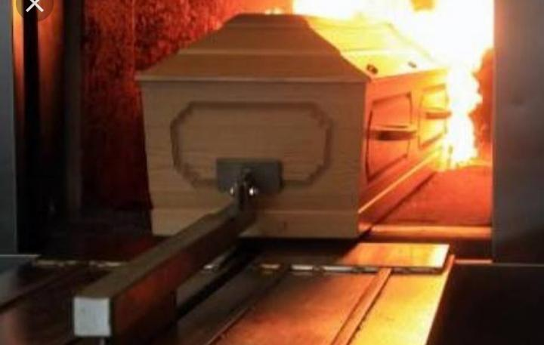
Cremation Pictures

Slide 4
Cremation
It is the best method. The usual quantity of fuel required to dispose the body in a proper way will be about 400pounds.
If this much amount is not used it will cause incomplete burning of the bodies.
Half burnt remains of the dead will be thrown into the stream or rivers which will be unsanitary.
Nowadays due to recent developments the idea of cremation has come into practice, where the bodies are cremated by the use of furnaces. When either by gas or electricity the bodies are exhumed. This is easy & sanitary method.

Slide 5
Advantage of crematoria – they occupy less space, body gets burnt completely in ½ hr. Whereas in ordinary burning process it takes one &half hours.
But this method is composed on medico legal ground, since this will leads to difficulties in investigation of any unnatural death.
following regulations are followed to minimize such difficulties :-
- a death certificate from a registered medical practitioner is compulsory before exhumation.

Slide 6
Provision of death register in the premises of the crematorium. The practice is to minimize any foul play or to help in case of any suspicion.
corporation & municipalities maintain burning & crematory areas.
All cremation ground & burning Ghats should be well lighted at nights & screened with high walls.

Slide 7
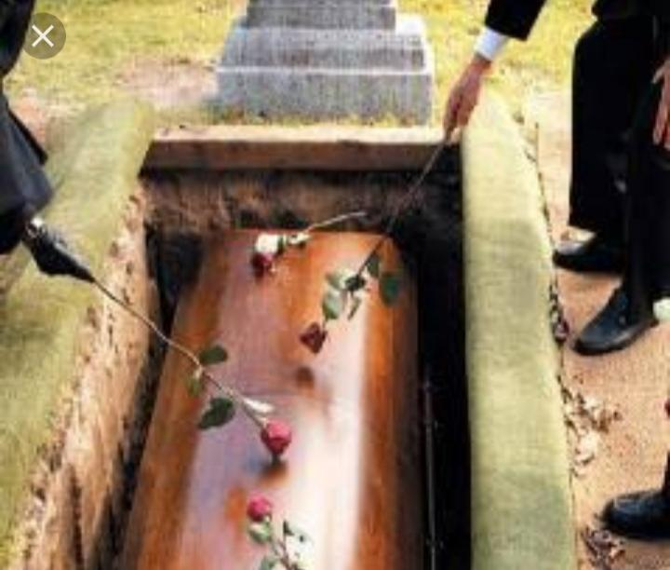
In burial coffin’ s pictures

Slide 8
Burial
Burial of a dead body is a expensive method since the party have to pay for the ground where the dead has to be buried & for the coffin, etc.
Follow these methods during disposal ;-
- location – it should not be too close to a residential area, but should be easily accessible by a road.
- site – the land to flooding is not unsuitable, nor should it be too high to pollute water at a lower level by natural drainage.

Slide 9
Soil – the soil should be light, free from water. The sandy loam soil is good, where soil bacteria help in the disintegration of the body. Chalky & clay soil Are to be avoided.
Size – ¼ acre land 1000 population is minimum requirement. A pit of 3-5 feet depth, never below 8 feet nor within 2 feet of the surface soil.
Coffins – it should be made of easily destroy able wood since heavy wooden coffin slow the disintegration of bodies.

Slide 17
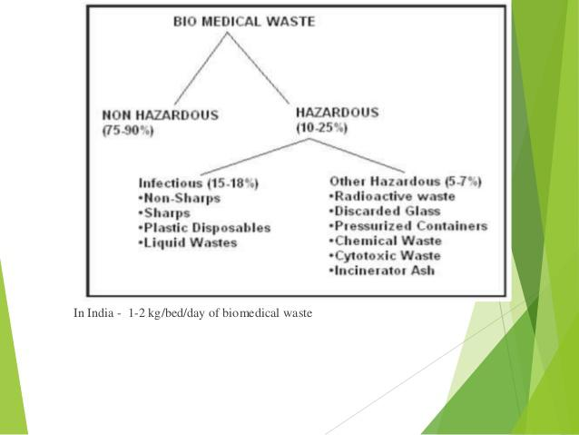

Slide 53
Question blog ?
Enlist the types disposal of dead bodies ?
List out the components of E – waste management ?
Steps in hazardous waste management ?

