Slide 1
Continuation of arthropods

Slide 2
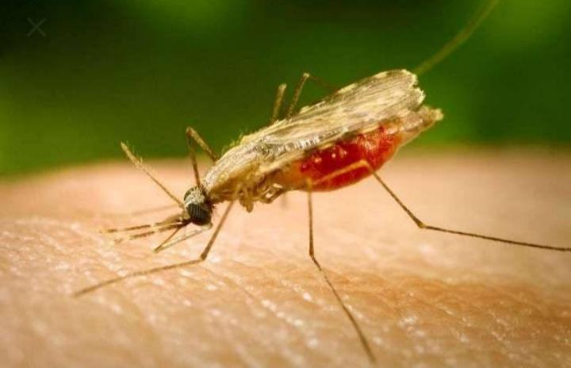
Sand flies

Slide 3
Sand fly
Sand flies are small insects, light, or dark brown in colour.
They are smaller than mosquitos. Their bodies & legs are full of hairs.
Some 30species of sand flies have been found in India. The important species are :-
Phlebotomus Argentipes
Phlebotomus papatasii
Phlebotomus sergenti.

Slide 5
Characteristics of sand fly
The body of a sand fly consists of head, thorax, &abdomen.
It has long legs, out of proportion compared with the size of the body.
The wings are upright.
The sand fly cannot fly, it only hops about.
Being small than a mosquito, it can pass through an ordinary mosquito net.

Slide 6
Life cycle

Slide 7
Life cycle
Egg – the eggs are laid in soil. Preferably near cattle, sheds poultry & similar other situations where soil is dump &dark.the eggs hatch within 7 days.
Larva – the larva is a hairy maggot( found in decaying matter). It lives in soil, feeding on decaying organic matter. The stage lasts for about 2week.
Pupa – the stage about 1week.
Adult – the adult sand fly for about 2 week.

Slide 8
Disease transmission
Only female sand flies bite & transmit disease. The disease transmitted are :-
- sand fly fever – Also known as three day fever Or phlebotomus fever Is a viral infection that causes Influenza like symptoms & characterized by a Rapid onset. The disease occurs in endemic areas In summer months, during sand flies are active.
- Oriental sore – Cutaneous Leishmaniasis ,a relatively mild skin disease commonly known as oriental sore . Most common form of leishmaniasis Affecting humans. It is a skin infection caused by a Single cell parasite. That is transmitted By the bite of a phlebotomine sand fly.

Slide 9
Control measures
Insecticides – sand flies are easily controlled by DDT, or lindane. A single application of 1to 2 grams of DDT or 0.2grams of lindane per square. Metre of area has been found to be very effective in controlling sand flies.
Sanitation – improvement of Peridomestic sanitation such as removal of shrubs, & vegetation within 50metres of human dwelling & cattle sheds should receive attention.

Slide 10
Louse

Slide 12
Louse
Louse is a small wingless insect. It is a ectoparasite ( parasite which lives on the body of the human or animal host).
Three kinds of lice which infest man :-
- head louse (pediculus capitis)
Body louse ( pediculus coaporis)
Pubic or crab louse (phthirus pubis)
Characteristics – the head & body are similar in appearance. The body is flattened. & is divided into head, thorax, and abdomen.

Slide 14
Lice occurs wherever standards of hygiene are poor.
Life cycle
There are three stages : egg, larva or ( nymph) & adult.
Egg- the eggs are called nits. A female lays upto 300eggs at a rate of 4to 9 each day.
Larva (nymph) – the larva looks very much like an adult, expect for its smaller size.
Adult – the entire life cycle from egg to adult louse takes about 15to 17 days. Adult lice live about 30-50day.

Slide 15
Control measures
Insecticides - for head louse & body louse application of DDT can be used.
Personal hygiene.

Slide 16
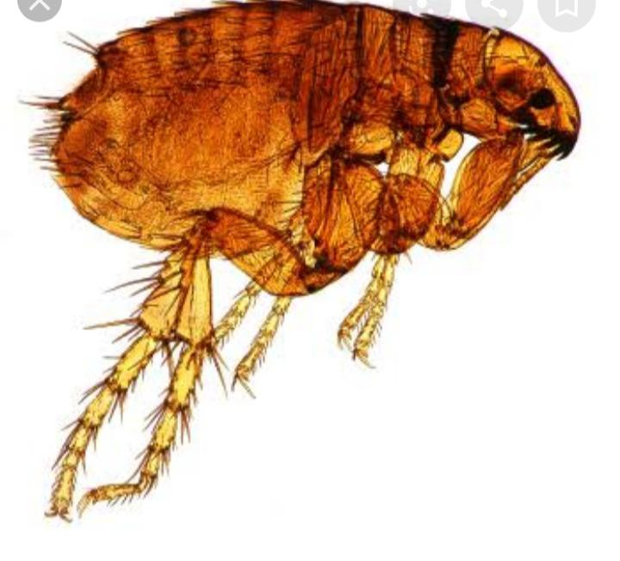
Rat fleas

Slide 17
Rat fleas
Different kinds of fleas infest different animals. Those that infest rats are called “rat fleas”.
similarly, there are cat fleas, dog fleas. The rat fleas have acquired great importance because they transmit disease plague. The common rat fleas are :-
*Xenopsylla cheopis
*Xenopsylla astia
*Xenopsylla braziliensis
The rat fleas is a small, brownish, wingless insect. It’s body is compressed from side to side. It’s body fairly tough.

Slide 18
Characteristics of rat fleas
The body of a rat flea is divided into head, thorax, & abdomen.
Head – the head projects downwards & bears short piercing mouth parts.
thorax – the thorax is divided into 3 segments- pro thorax, mesothorax, metathorax. There are 3pairs of legs attached to the thorax. The fleas has no wings.
Abdomen - the abdomen consists of 10segments . In male there is coiled structure called penis situated in the posterior part of abdomen. In female there is a short stumpy structure called spermatheca.

Slide 19
Life cycle

Slide 20
Life cycle
Egg – the eggs are deposited in rat holes & on the hairs of the rat. A female may lay up to 300-400 eggs in its life time. The eggs hatch in 2-7 days.
Larva- the larva looks like a caterpillar. It moults & becomes bigger in size. The duration of larval stage is about 2 weeks
Pupa – the pupa stage lasts for 1-2 weeks.
Adult – the life cycle of the fleas is complete in about 3-4 weeks. The fleas lives normally for a month.

Slide 21
Control measures
Insecticides – fleas are quickly controlled by spraying 10% DDT dust or 5 % malathion dust. The insecticidal powder must be dusted over rat runs, under carpets, gunny bags & other areas. The dust must also be blown into rat holes with the help of dust blowers.
Control of rats – when the rats are controlled, fleas are also controlled.

Slide 22
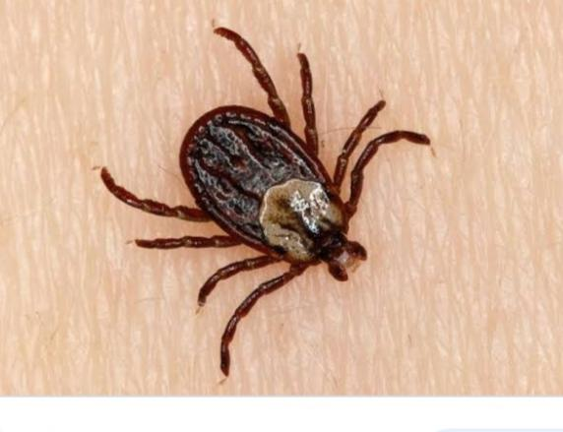
Ticks

Slide 23
Ticks
Ticks are ectoparasites of vertebrae animals. Sometimes they attack man & transmit disease. Ticks are of 2kinds – hard, soft.
Hard ticks – the hard tick is so called because the dorsum of its body is covered by a hard shield called scutum.
This is absent in soft ticks. The body of a tick is oval in shape. There is no clear vision of the body into head, thorax, & abdomen. The adults have 4 pairs of legs. Sexes are separate. The males are generally smaller than females. Both sexes bite & suck blood.

Slide 24
Hard & soft ticks

Slide 26
Soft ticks –
- it is so called because, it does not possess the hard dorsal should present in hard ticks.
- the body does not show any division between head, thorax & abdomen.
- the head is situated Ventrally, & is not seen from above. This makes it easy to identify a soft tick from a hard tick.

Slide 27
Life cycle of ticks
There are 4 stages in life history of both hard & soft ticks – egg, larva, nymph, & adult.
The entire life cycle from egg to adult takes about 2 months in the case of hard ticks, & from 9-10months in case of soft ticks.
Ticks live for a year or more.
Disease transmitted – hard ticks – tick typhus, haemorrhagic fever,
Soft tick – relapsing fever.

Slide 28
Control measures of ticks
Insecticides.
Sanitation.
Protection of workers.

Slide 29
Itch mite

Slide 30
Itch - mite
The itch mite ( Sarcoptes scabiei or acarus scabiei) is an extremely small arthropod. It is just visible to the naked eye, measuring 0.4mm in size.
It is an ectoparasite of man – that is, it lives & breeds in human skin and causes a disease known as scabies.
The body of a itch mite is shaped like a tortoise.
It is rounded above & flattened below.

Slide 32
There are numerous folds on its body with short bristles.
The itch – mite has 4pairs of legs – the front 2 pairs end in long tubular processes known as suckers, the hind legs end in long bristles.
The itch mite burrows into the superficial layers of the skin (epidermis) where it lays eggs.

Slide 33
Life - cycle
Egg- the female burrows into the superficial layers of the skin& lays eggs. The egg hatch into larvae in 3-4 days. A single female may lay up to 30eggs at the rate of 2-3 per day.
larva – this stage lasts for 3 days.
Nymph – this stage occupies 6-8 days.
Adult – the life cycle from egg to adult takes 10-15 days. The adult mite lives for 1-2 months.

Slide 34
Rodents
Rodents are part of man’s environment. Often their number exceed human population. By living in close association with man they not only cause economic loss by damaging buildings, foodstuffs, & other commodities, but also act as sources of reservoirs of some important communicable diseases to man such as plague.
A type of small mammal With sharp front teeth. They include rats, mice, squirrel, etc.

Slide 35
Types of rodents
There are 2 main types of rodents – domestic & wild.
Domestic Rodents – the well known domestic rodents are rattus rattus ( house rat) & rattus Norvegicus (sewer rat).
Wild rodents – there are many species of wild rodents. One particular importance in India is tatera indica, which is natural cause of plague.

Slide 36
Rodents are associated with a number of diseases. These are : plague, rat – bite fever, amoebic dysentery, salmonellosis.
Some of disease are transmitted directly through rat – bite (rat bite fever), some through contamination of food or water (salmonellosis), & some through rat fleas (plague)

Slide 37
Control of rodents
Trapping – it is an ancient device for capturing rats. The captured rat must be destroyed, these is usually done by immersing the trap in water. Trapping causes a temporary reduction in the number of rats. To be effective, it must be done on a community basis. Rats by nature are suspicious animals, they soon become trap – wise & avoid traps.
Rat poison – there are many rat poisons. The commonly used one are barium carbonate, zinc carbonate.

Slide 38
- barium carbonate – baits are prepared by mixing 4 parts of wheat or rice flour, & 1part of barium carbonate. The mixture is made into small round Marbles with water. The baits are placed near rat holes, and along rat runs. On eating the pills, the rats are killed in 10-48hours.
- Zinc phosphate – this is used in the ratio of 1part of zinc phosphide to 10 parts of wheat flour. These are very poisonous. Rats are killed in 3hrs.

Slide 39
Fumigation – cyanogas ( calcium cyanide) is used for the fumigation of rat burrows. About 2ounces (55gms) of the chemical is pumped into each rat burrows using a special “ Foot pump”.the chemical on contact with moisture gives off hydrogen cyanide gas which kills both rats & rat fleas.
Improvement of sanitation.

Slide 40
Question blog?
Enlist the life cycle of rat fleas?
List out the characteristics of sand fly?
Explain the control measures of rodents?

