Slide 1
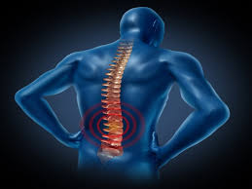
SPINAL CORD INJURY
By – Mr. Bahar

