Slide 2
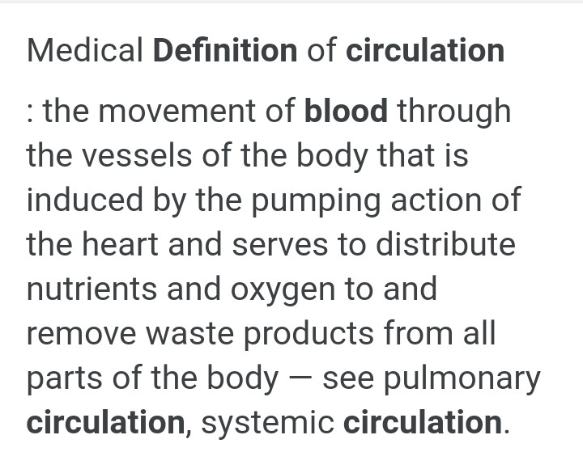

Slide 3
PULMONARY CIRCULATION
The course of blood from right Atrium to left ventricle is called as pulmonary circulation .
#. the impure blood all over the body filter through superior and inferior Vena cava .
#. from right Atrium when pressure increases the impure blood increases into right ventricle through bicuspid valve.
#. when pressure increases in right ventricle impure blood goes to the lungs for purification through pulmonary artery.
#. After leaving the heart Pulmonary artery divided into right and left Pulmonary artery ,which carries the impure blood to lungs where exchange of gases takes place ,carbon dioxide is excreted and oxygen is absorbed.

Slide 4
#. The right Pulmonary artery divides into two branches in 3 lobed lungs,the larger branch carries blood to the middle and lower lobes, and the smaller branch to the upper lobe .
#. the left Pulmonary artery divides into 2 branches in two lobed left lungs and each branch supply blood to respective lobes.
#. The blood capillaries and arterioles contains carbon dioxide and alveoli contains oxygen .
#. the exchange of gases takes place in the lungs which results in the purification of blood.
#. the pure blood from the lungs reach the left Atrium via two pulmonary veins .
#. from the left Atrium pure blood enters into the left ventricle during atrial systole through bicuspid valve.

Slide 5
#. From the left ventricle pure blood flows into the Aorta during ventricular systole, then blood movies to parts of the body from the Aorta.
#. the Aorta is first artery of general circulation.
#. the tricuspid valves and bicuspid valves are the control of chordae tendineae, which are stimulated by purkinje fibres.

Slide 6
SYSTEMIC CIRCULATION
#. The systemic circulation starts from Aorta.
#. the pure blood is flows into Aorta from the left ventricle.
#. the course of blood from left ventricle to right Atrium is called as systemic circulation or general circulation .
#. the Aorta divides and re divides to form a artery, arterioles and capillaries, these supply pure blood and nutrients to the entire body .
#. the same set of blood capillaries collects waste material from the body cells..
#. The capillaries unite to form venules and veins.
#. the venules and veins collect impure blood and takes it into the heart through superior and inferior Vena cava

