Slide 1
Introduction to Gynecological Nursing
Ms. Anju Ajikumar

Slide 2
INTRODUCTION
Gynecology normally means treating the women who are not pregnant, while obstetrics deals with pregnant women and their unborn children, but both are interrelated to each other.

Slide 3
DEFINITION
Gynecology is the branch of physiology and medicine which deals with the functions and diseases specific to women and girls, especially those affecting the reproductive system.

Slide 4
GYNAECOLOGICAL HISTORY TAKING AND PHYSICAL EXAMINATION

Slide 5
HISTORY TAKING
Authenticity, systematicness and integrity of medical history, largely depend on the interrogation methods and skills
Good communication is necessary for the assessment of patient's condition and treatment.
Communication technique:
- Concentration
- Knowledge
- Kindness
- Humour?

Slide 6
THIS INCLUDES…..
General history
Chief complaints
Present medical history
Past medical history
Past surgical history
Menstruation history
Marriage history
Personal history
Family history

Slide 7
GENERAL HISTORY
Name, Gender, Age, Nationality,marriage, occupation, hometown
Address, time of Hospitalization, history collecting time, history provider

Slide 8
chief complaints
The main symptoms of or the duration of symptoms(using the professional term)
For example,
12 weeks menopause, vaginal bleeding for 2 days,abdominal pain for one hour
Uterine fibroids found for one month in gynecological check up
G2P0 pregnancy 37+6weeks, bloody show for 3 hours

Slide 9
PRESENT MEDICAL HISTORY
Focused on the chief complaint _ occur, evolution, diagnosis and treatment procedure
Onset and duration of ilness
The main symptom characteristics
Causes and incentives
Accompanying symptoms
Related positive and negative informations
Diagnosis and treatment process
Diet, sleep, body weight,, stool and urine

Slide 10
MENSTRUAL HISTORY
Age of menarche, menstrual cycle,volume,associated symptoms, LMP/PMP,amenorrhea, menopausal age date
LMP : Last Menstrual period
PMP : Previous Menstrual period
For example,
The female patient, 27years old, complaint in August menstruation was late and previous menstrual date was in july 16th.Menarche occured in junior high, normally 2 days ahead of each period. Much volume in first 2days, less after and accompanied by mild back pain.

Slide 11
OBSTETRIC HISTORY
Year and date | Pregnancy events | Labour | Types of delivery | Puerperium | Baby status
 | Full term | Normal | Normal vaginal delivery | Postpartum hemorrhage | Sex and weight
 | Post term | Obstruted labour | NVD with episiotomy | Postpartum infection | Condition at birth
 | Pre term | Others | Cesarean section/forceps/ventouse | Contraception | Duration of breast feeding
 |  |  | MTP/Self abortion |  | Immunization

Slide 12
MARITAL HISTORY
GYNECOLOGICAL HISTORY
Marriage history (age of marriage and times of marriage)
Health condition of husband
Birth control measures
History of gynaecological disorders such as reproductive tract infections/salpingitis/endometriosis/tubo-ovarian abscess
Ectopic pregnancy/infertility
Hiv/Hepatitis/Syphilis toxoplasmosis /other infections/rubella/cytomegalovirus/herpes simplex(STORCH)

Slide 13
PAST MEDICAL HISTORY
PAST SURGICAL HISTORY
Previous health condition
General health condition and medical history
History of any chronic illness or genetic disorders
History of any previous general, obstetric or gynecologic surgery
If any, nature of operation, anesthetic procedure, bleeding or clotting complication

Slide 14
PERSONAL HISTORY
FAMILY HISTORY
Birth place, previous location
Bad habits for cigarettes and alcohol
If married, details of sexual history and contraceptive practice
History of taking drugs for a long time or allergy to certain drugs
Health conditions of parents,cousins or siblingsand children
It is of occational value.

Slide 15
PHYSICAL EXAMINATION
General and systemic examination
Gynecological examination
Breast examination
Abdominal examination
Pelvic examination

Slide 16
GENERAL AND SYSTEMIC EXAMINATION
It should be thorough and meticulous
Height/weight
Vital signs
Bulid : obese/average/thin
Check for:
Nutritional status
Pallor
Tongue, teeth, gums and tonsils
Neck(neck veins, thyroid gland, lymph nodes)
Edema of legs

Slide 17
BREAST EXAMINATION
Introduce yourself to patient
Undress to waist, sit on couch at 45 degrees
Maintain patient dignity e.g. Bed sheet
Assess in following positions
Patient’s hands behind their head (accentuate lumps, asymmetry, tethering)
Pushing against their hips (accentuate lumps attached to pectoralis muscle)
Patient leaning over side of bed (accentuate abnormalities in large breasts)
Exam good breast first, then the ‘diseased’ breast

Slide 18
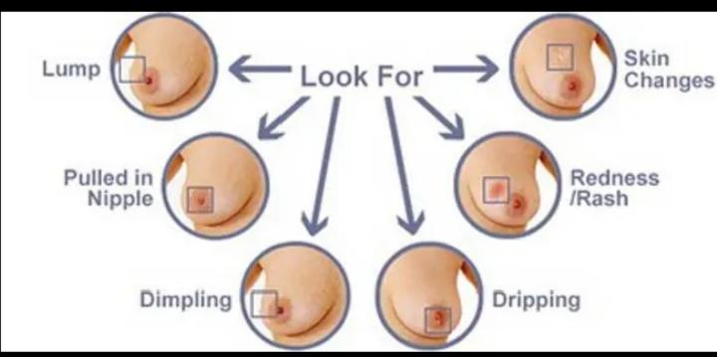
Inspection

Slide 19
6 S’s
Site
Size
Shape
Symmetry
overlying Skin
associated Scars
Nipple signs; 6 D’s
Paget’s Disease Depression Deviation
Discharge Displacement Destruction

Slide 20
Fungation; comment on presence of fungating carcinoma (check inframammory fold)
Asymmetry; carcinoma may be present in higher breast
Tethering; due to infiltration of ligaments of Astley-Cooper
Peau d’orange; micro-oedema
Lymphoedema; may indicate lymphatic infiltration by carcinoma or previous surgery with LN removal
Erythema

Slide 21
Palpation
Ask about pain and if patient has a lump.
Examine good breast first then diseased breast
Patient puts hand behind head on exam side
Check for temperature change
Use following with lumps;
Surface
Edge
Consistency (hard, firm, soft)
Fixity to skin and underlying structures
Fluctuance
Pulsatility and expansility
Transilluminability
Reducibility

Slide 22
Palpate using palmar surfaces of index, middle & ring fingers of both hands, sweeping down clock face positions.
N.B. Most carcinomas present in upper, outer quadrant

Slide 23
ABDOMINAL EXAMINATION
Prerequisites:-
Empty the bladder
Provide dorsal supine position to the patient with legs slightly flexed to relax the abdominal muscles
Stand on the right side of the patient
Provide privacy
Establish good rapport with the patient and explain the whole procedure to win the confidence

Slide 24
Inspection –
look at contour, any obvious mass or distension
Presence of surgical scars, dilated veins or stretch marks
Raise her head and cough-checking for hernias
Palpation-
pain ask for site of pain (leave until last) palpate in 4 quadrants
Examination for masses and organomegaly
Characteristic of pelvic mass is that you cant palpate below it
Look for signs of peritonism (guarding and rebound tenderness)
Inguinal herniae and lymph nodes

Slide 25
Percussion-
useful if free fluid suspected (?asities)
Shifting dullness/fluid thrill
Enlarged bladder will be stony dull to percuss
Auscultation-
not specifically useful in gynae but a pt will sometimes present with an acute ado ?bowel obstruction/ post op with ileus so you could listen for bowel sounds

Slide 26
PELVIC EXAMINATION
Inspection of external genitalia
Vaginal examination
Rectal examination
Rectovaginal examination

Slide 27
Prerequisites:-

Slide 28
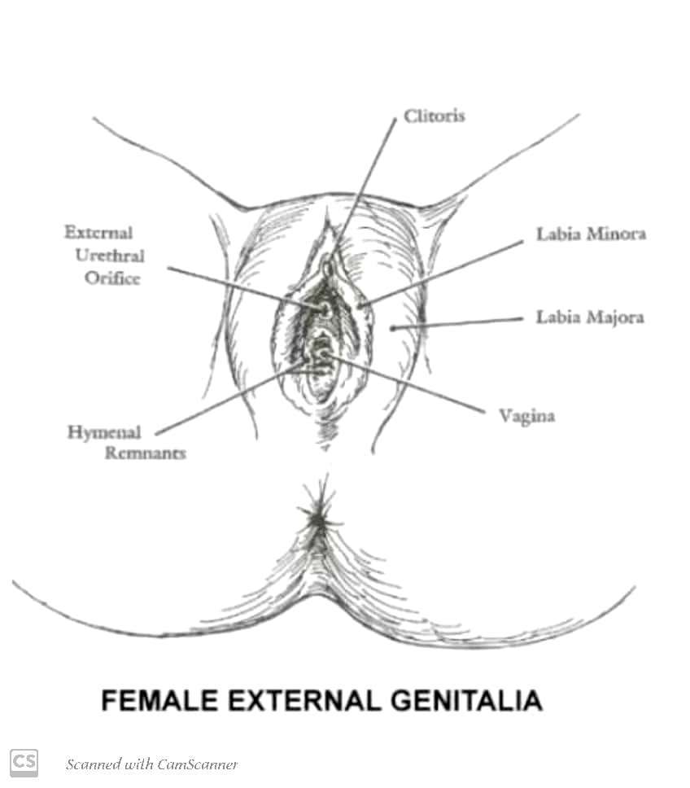
Inspection of external genitalia
Inspect the vulva from above downwards for any congenital abnormality:

Slide 29
Vaginal examination

Slide 30
Speculum examination

Slide 34
Thank you!

