Slide 1
MUSCULAR SYSTEM
BY
Mrs. GOWRI.R
ASSISTANT LECTURER
BGI

Slide 2
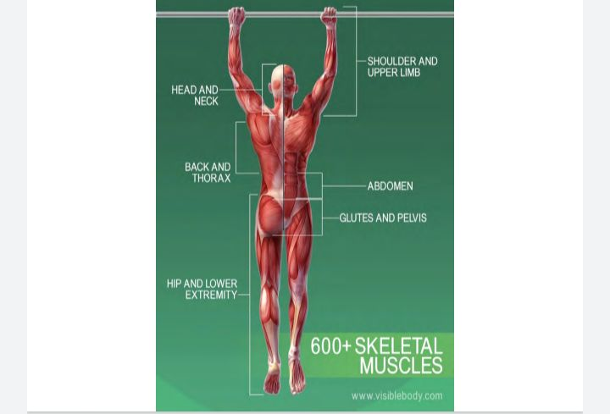

Slide 3
DEFINITION
Muscle tissue is composed of cells that are specialized to shorten in length by contraction. This contraction results in movement. It is in the way that practically all movements within the body or movements of the body in relation to the environment are produced.

Slide 4
CLASSIFICATION OF MUSCLE
There are three types of muscles: Skeletal muscle: . Cardiac muscle ,Smooth muscle

Slide 5
STRUCTURE OF SJELETAL MUSCLE

Slide 6
SKELETAL MUSCLE
STRUCTURE OF SKELTAL MuscLE Skeltal muscle is also Called astraited muscle under light microscope the colk or muscle fiber shows prominent transverse xtrah ans and pesspharely placed nuclei

Slide 7
SPECIALIZED FUNCTION OF SKELETAL MUSCLE
1. CONTRACTION: It is the ability of a muscle to shor2. ELASTICITY: The skeletal muscle can be stretched by a weight; when the weight is removed, muscle returns to its normal length. 3.MAINTENANCE OF POSTURE: The skeletal muscles can counteract the force of gravity, thereby helping in the maintenance of posture.ten and thicken.

Slide 8
ORGANIZATION
S keltal elongated. fiber Composed of nume Celk called muscle fiber are arranged in bundles Called fanciull Each muscle fiber is surrounded Loose alveolar Connective tissue asheath, Catted Each 也 facculoos is coveromyscam. There musele by a aston ger Connective by peńmyxum. tissue sheath called The Whole muscle is enveloped by a tough Connective apimycium. sheath Called as epimycium

Slide 9
Muscle fiber Musele J asize the fiber are Elength the size and size elongated Cells the according Various acc ashape of to the muscle.
. Each muscle fiber is surrounded plasma membrane, or cell membrane.
• Just beneath which dive many flattened. nyctie. "The cytoplasm is called sacroplasm rich in mitochondria and fine longitudinal threads Called miofihrils.

Slide 10
MICROSCOPY STRUCTURE OF MYOFIBEELS
High microscopic studies each myofibril Consist of two alternative bande.
1 light band. /I
2. Dark band /A

Slide 11
1. LigHT BAND /I The light band is called 'I' band because it is isotrophic polasized light. When the palanged light is passed through "the muscular fiber at this area the light rays are reflected at the same angle
•I band is divided into two portion by a narrow dark line called Z line or Z disc( Z -Z wishensxhi dist. The z line is formed by protein which does not permit the passage of light. t
The posture of omborigfile in between two z line is called "sacromere".

