Slide 1
SCAPULA
BY
MRS GOWRI .R
BGI

Slide 2
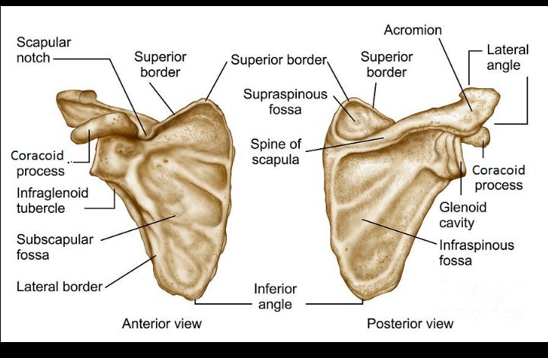

Slide 3
DEFINITION
The scapula, or shoulder blade, is a large triangular-shaped bone that lies in the upper back. The bone is surrounded and supported by a complex system of muscles that work together to help you move your arm.

Slide 4
FUNCTIONS
Gives attachment to muscles.
Has a considerable degree of movement on the thoracic wall to enable the arm to move freely.
The glenoid cavity forms the socket of the shoulder joint.
Because most of the scapula is well protected by muscles and by its association with the thoracic wall, most of its fractures involve the protruding subcutaneous acromion.

Slide 5
ANATOMICAL FEATURES
It is a large bone situated on each side of the upper part of postero latrat aspect of thorax.
It is a flat triangular shaped bone.
Its extend from 2nd to 7th ribs.
The body of scapula conuit of 2 surfaces ,3 boarders , 3 angles.

Slide 6
SURFACES OF SCAPULA
There are two surfaces of scapula
(a) Coctal surface or ventral surface (Anterior aspect)
(b) Dorsal surface (Posterior aspect)
(a) Castal surface: 1. costal surface is concave. It is also called subscapular fossa. 2. Manked by three longitudinal ridges ℗
(b)Dorsal Surface:1. It is divided by spine of Scapula, into a upper smaller supraspinous fossa and larger lower inforaspinous fossa.
2.Two fossa communicated below the spine by the spinglenoid notch.

Slide 7
BORDERS OF SCAPULA
(a) Superior border:
It is thin and is shortest It extends from the root of coracoid process to superior angle
Near the root of coracoid process it presents with a suprascapular notch
(b)Medial or vertebral border:
It is thin abd extended from superior to inferior angle
(C) lateral border:
Its is the thickest and extend from the glenoid cavity to inferior angle

Slide 8
ANGLE OF SCAPULA
(a) Superior angle:
↓ Is covered by trapezius
(b) Inferior angle :
Is covered by latissimus dorsi Corresponds to the 7 rib
. (c) Lateral angle :
It is broad and consists of glenoid fossa It articulates with the head of humerus forming the shoulder joint. Upper end has a supraglenoid tubercle.
It is characteristically intracapsular in position Glenoid cavity is known as head of scapula and is attached to rest of body by a constricted portion known as neck of scapula.

Slide 9
PROCESS OF SCAPULA
(a) Spinous process :
It is the largest process on dorsal surface of scapula
Is a triangular plate of bone with 3 borders namely anterior, posterior and lateral
The posterior border is known as the crest of spine
The lateral border is curved and forms the spinoglenoid notch
The anterior border is attached with the dorsal surface .

Slide 10
(B) Acromian Process :
. It consist of two border and two surface
(C) coracoid process:
.It is projection form upper part of glenoid cavity or fossa.

