Slide 1
PELVIC INFLAMMATORY DISEASE

Slide 2
PELVIC INFLAMMATORY DISEASE
Pelvic inflammatory disease (PID) is an infection of the female upper genital tract, including the uterius,fallopian tubes and ovaries.
Causes
Many types of bacteria can cause PID, but gonorrhea or chlamydia infections are the most common. These
bacteria are usually acquired during unprotected sex, following childbirth, miscarriage or abortion.
Risk Factors
* Being a sexually active woman younger than 25-year-old.
* Having multiple sexual partners.
*Being in a sexual relationship with a person who has more than one sex partner.
*Having sex without a condom.
*Douching regularly, which upsets the balance of good versus harmful bacteria in the vagina and might mask symptoms.
*Having a history of pelvic inflammatory disease or a sexually transmitted infection (STIs).
Signs and Symptoms
*Pain in lower abdomen and pelvis
*Heavy vaginal discharge with an unpleasant odor.
*Abnormal uterine bleeding, especially during or after intercourse, or between menstrual cycles.
*Pain during intercourse
*Fever, sometimes with chills
*Painful or difficult urination.
*Signs of shock, like fainting
*Nausea and vomiting.

Slide 3
Investigation
*Pelvic examination: To look for:
*Bleeding from cervix
*Fluid coming out of cervix Pain when cervix is touched
*Tenderness in uterus, tubes, or ovaries
* Lab tests to check for signs of infection
*: Reactive protein (CRP)
*Erythrocyte sedimentation rate (ESR)
WBC count
Other tests include:
Vaginal or cervical Swab to check for gonorrhea, chlamydia, or other causes of PID.
Pregnancy tests.
Pelvic ultrasound or CT scan to see what else may be causing these symptoms. Appendicitis pocket of infection around tubes and ovaries may cause similar symptoms.
*pregnancy test

Slide 4
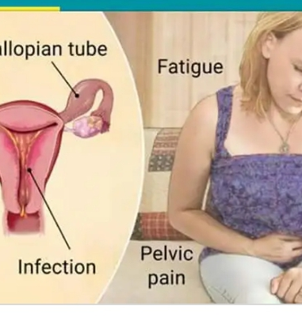
Complications
*Endometritis
*Salpingitis
*Tubo-ovarian abscess (TOA)
* Pelvic peritonitis
*Periappendicitis
*Perihepatitis
.

Slide 5
Prevention
Regular testing for sexually-transmitted infections is encouraged for prevention. The risk of contracting pelvic inflammatory disease can be reduced by the following:
Using barrier methods such as condoms.
Seeking medical attention if person experiencing symptoms of PID.
Using hormonal combined contraceptive pills also helps in reducing the chances of PID by thickening the cervical mucosal plug and hence preventing the ascent of causative organisms from the lower genital tract .
Seeking medical attention after learning that a current or former sex partner has, or might have had a sexually-transmitted infection.
Getting an STI history from current partner and strongly encouraging they be tested and treated before intercourse
Diligence in avoiding vaginal activity, particularly intercourse, after the end of a pregnancy (delivery,miscarriage, or abortion) or certain gynecological procedures, to ensure that the cervix closes.
. Reducing the number of sexual partners.
• Sexual monogamy that restricts sexual activities to two 'virgins' or partners remaining sexually exclusive with each other and having no outside sex partners.
• Abstinence.
Get regular STI screening tests.
Do not douche. Douching removes some of the normal bacteria in the vagina that protect the person from infection Douching may also raise the risk for PID by helping bacteria travel to other areas, like uterus, ovaries, and fallopian tubes.
• Do not abuse alcohol or drugs. Drinking too much alcohol or using drugs increases risky behavior and may put the person at risk of sexual assault and possible exposure to STIs.

Slide 6
Treatments
Antibiotics: Typical regimens include cefoxitin or cefotetan plus doxycycline, and clindamycin plus gentamicin. An alternative parenteral regimen is ampicillin/sulbactam plus doxycycline.
⚫ Treatment for partner: To prevent reinfection with an STI, sexual partner should be examined and treated. Infected partners might not have any noticeable symptoms.
Temporary abstinence: Avoid sexual intercourse until treatment is completed and tests indicate that the infection has cleared in all partners.

